Slide 1
Changing Nature and Importance of Long Range Demand Forecasting
ACWA Fall Conference 2016
November 30, 2016
Finance Program - Forecasting Water Demand
Ken Weinberg
Ken Weinberg Water Resources Consulting LLC

Slide 2
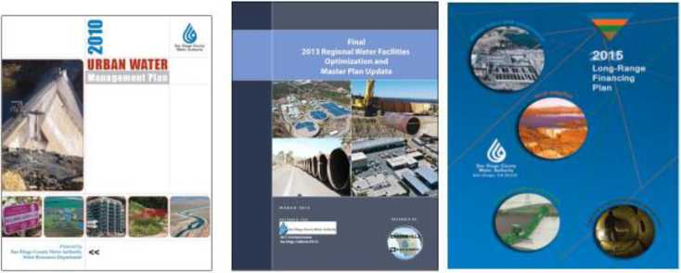
Demand Forecasting is the Foundation of Key Planning Documents

Slide 3
Types of Demand Forecasting
Short Term Sales Forecast
Budgetary and water rates
Operational
Long Range Demand Forecast
Quantifying supply need
Long range capital planning and financing
CEQA Compliance: Purpose and Need
Developing nexus for growth charges (Capacity Charges)
Hopefully, both forecasts align
Long Term
Short Term

Slide 4
Evolving Nature of Urban Water Demand Forecasting
Escalation of Water Use and Population
Increase water use by some annual percentage
How many more people and how much more water will they use
Econometric and Land Use Based Forecast
Demographic forecasting became more sophisticated
Competitive funding drove need for better forecasting of capital investments
ACOE IWR MAIN became the cutting edge forecasting tool
• In California external factors drove the use of more sophisticated demand forecasting

Slide 5
Key Legislation Requiring Water Demand Forecasting
1983: Urban Water Management Plan Act
Required urban suppliers serving 3,000 AF or 3,000 connections to prepare a plan every 5 years
Amended 20 times since passage to require better planning
1983: AB 1600 Mitigation Fee Act
Growths fair share requires quantifiable nexus
2001: SB 610 and SB 221
Required water suppliers to prepare water availability assessments and verifications for land use agencies in land use approval process

Slide 6
Key Legislation Requiring Water Demand Forecasting
2009: SBx7-7
State mandate for retail agencies to reduce consumption 20% by 2020
Achieved through conservation savings and recycled water project development
Post 2016 : SWRCB/DWR Conservation Regs
Drought Experience driving more ambitious conservation goals
SBx7-7 goals now considered too easy

Slide 7
Land-Use and Water Supply Coordination in the San Diego Region
Cities/County General Plans
Projected Water Demands
SANDAG’s Regional Growth Forecast
Urban Water Management Plan
Cities/County Plans & Policies
Water Assessment (SB 610) Written Verification (SB 221)
SANDAG Regional Plan

Slide 8
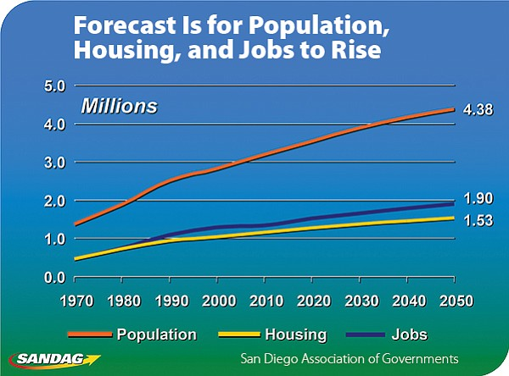
Simplified Example of Econometric Demand Forecasting
Driver Variables
Most important factors affecting forecasted water use
Derive from long range demographic and economic forecasts
Relies on past patterns of water use to predict future water use
• Econometric & Land Use Based Demand Forecast
•Links to regional land use planning and demographic forecasts
Housing, employment, household income, weather, cost of water

Slide 9
Projected San Diego County Employment Growth
SANDAG Series 13 Growth Forecast
32% increase in jobs
460,000 new jobs
1.45 million in 2012 to 1.91 million by 2050
Contributing factor to increased water consumption
Notes:
IN OUR BAR CHART COMPARING 1990 AND 2015 KEY METRICS, WE SAY THERE WERE 1.3 MILLION FULL-TIME JOBS IN SAN DIEGO COUNTY IN 2015. THIS SAYS THERE WERE 1.45 IN 2012. SOMETHING SEEMS AMISS WITH THESE INCONSISTENCIES. (added by DC – 2/10/16)
SANDAG’s Series 13 Regional Growth Forecast projects a steady increase in civilian jobs through the year 2050 – on average roughly 12,000 new jobs per year between 2012 and 2050.
This represents a 32% increase in the number of jobs from 1.45 million in 2012 to 1.91 million by 2050.
These additional 460,000 new jobs that enhance our local economy are a contributing factor to the region’s projected increase in water consumption.

Slide 10
Water Authority Service Area Population Growth
Based on SANDAG Forecast
Series 13 projections
Includes 2010 Census counts
Additional 2/3 million people between 2015 and 2040
Total service area population roughly 3.8 million by 2040
In-region births over deaths account for 2/3 of population growth
Million
Projected
Historic

Slide 11
SBX7-7 : The Math Gets Easier or Mandated Water Use
Demand = ((GPCD Target X Estimated Future Population) * 365 days)
Conservation = Econometric or Land Use Forecast -
((gpcd target X Future Population) X 365 days)

Slide 12
Determining Projected Total Demands (Illustrative Purposes)
Conservation
12

Slide 13
Questions To Consider
1. What is the value of sophisticated demand forecasting using hypothetical historic water use data when total use will be mandated?
If facilities are sized to meet mandated use what happens if it is not achieved?
3. What is the effect on capacity charges if future use goes down or is stable, what is growth’s fair share?

