Slide 1
Water Use Efficiency Work Group
Bi-Monthly Meeting
May 24, 2023
10:00 AM – 12:00 PM

Slide 2
Meeting Agenda
May 24, 2023 10:00 AM – 12:00 PM
Chair Welcome – Elizabeth Lovsted
Regulatory Update
State Water Board Rulemaking – Elizabeth Lovsted
ACWA WUE Working Groups – Sonja Eschenburg
Drought EOs – Chelsea Haines
Drought & Conservation Technical Reporting Order – Chelsea Haines
Legislative Updates – Julia Hall
ACWA Advocacy
ACWA March 2023 Comments: Overarching - Chelsea Haines
Outdoor Standards – Fiona Sanchez
CII performance Measures – Ariel Flores
Methodology & Variances – Elizabeth Lovsted
Coalition Partners: Advocacy & Assistance Priorities
WateReuse California – Rosario Cortes
CASA – Jared Voskuhl
CA-NV AWWA – Sue Mosberg
CalWEP – Tia Fleming

Slide 3
Regulatory Update: SWRCB Rulemaking
Elizabeth Lovsted
State Water Board Formal Rulemaking – Expected “May 2023”
Water Conservation Portal
Stay informed by subscribing here
State Water Board informal Proposed Regulatory Framework – March 2023
Report Here
DWR WUE Recommendations – September 2022
Recommendation include: Outdoor Standards, Variances, Performance measures
21 Technical Reports
Reports Available Here
ACWA Comments Letters: (link to all ACWA WUE Comment Letters)
March 30, 2023 – State Water Board Proposed Regulatory Framework
February 14, 2022 – DWR Draft CII Performance Measures
November 24, 2021 – DWR Draft Water Conservation Legislation Material
February 11, 2021 – Landscape Area Measurement Data

Slide 4
Regulatory Update: ACWA Working Groups
Sonja Eschenburg
Outdoor Working Group: recurring meetings on Monday afternoons, starting June 12th, from 1:00 – 2:00 pm, for a total of 4 weeks
CII Working Group: recurring meetings on Tuesday afternoons, starting June 13th, from 1:00 – 2:30 pm, for a total of 8 weeks
Methodologies & Variances Working Group: recurring meetings on Wednesday afternoons, starting June 14th, from 2:00 – 3:30 pm, for a total of 8 weeks
Bi-Monthly Meeting Calendar: (Visit ACWA Events)
May 24th from 10:00 am – 12:00 pm
July 12th from 10:00 am – 12:00 pm
September 13th from 10:00 am – 12:00 pm
November 8th from 10:00 am – 12:00 pm
Should you have any questions, please contact Sonja Eschenburg (sonjae@acwa.com).

Slide 5
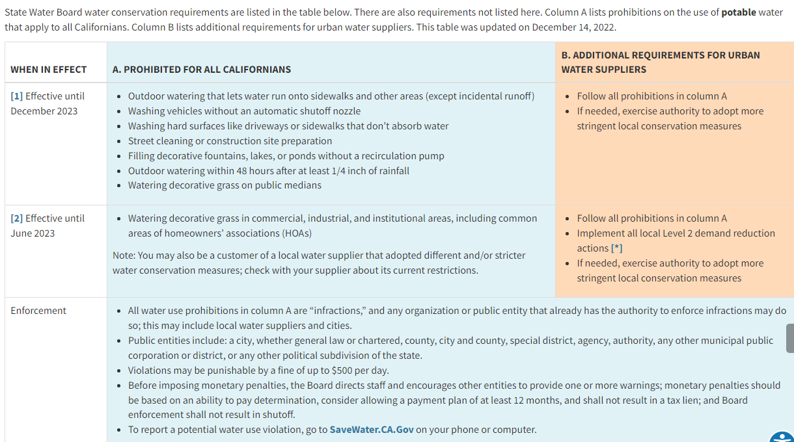
Regulatory Update: Drought EOs
Chelsea Haines
https://www.waterboards.ca.gov/water_issues/programs/conservation_portal/regs/emergency_regulation.html

Slide 6
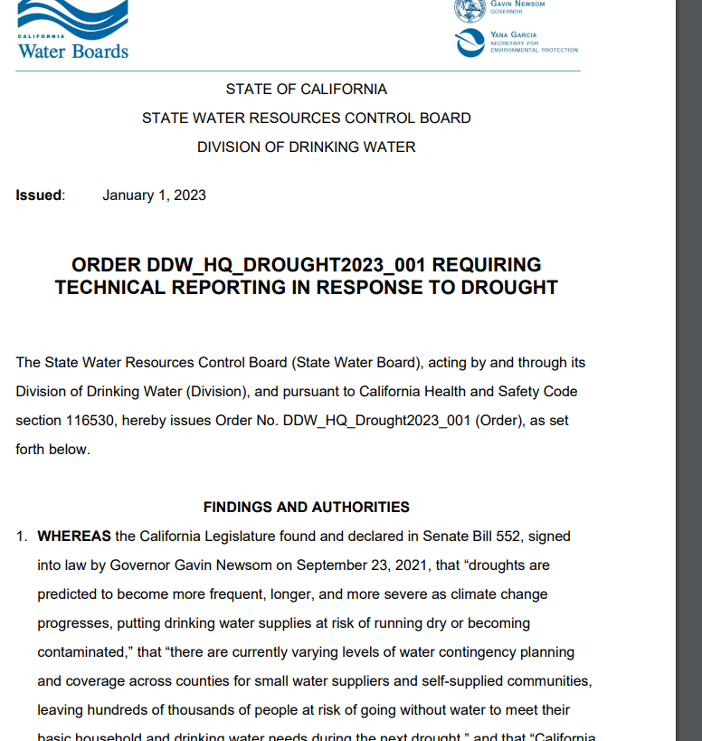
Regulatory Update: Reporting Order
Chelsea Haines
Jan. 1, 2023 - Reporting Order
ACWA Working Group:
Process Concerns
Policy Concerns
Technical Concerns
Next Steps:
Technical Concerns
June 6th State Water Board Information Item

Slide 7
Legislative Updates
Julia Hall
AB 1572 (Friedman) Nonfunctional Turf
Significant Amendments – SLC to reconsider position 5/26
2. AB 1573 (Friedman) MWELO
Some positive amendments – likely no position change
3. AB 1072 (Wicks) Rebate Programs and Low-Income Residents
Bill held on suspense – Two-year bill

Slide 8
ACWA Advocacy: March 2023 Comments
Chelsea Haines
Overarching Policy Considerations
Water suppliers and Californians need adequate time to comply with the goals of Making Water Conservation a California Way of Life in a manner that is 1) cost-effective and 2) realizes multiple benefits
The intent of the Regulation is to provide flexibility to implement locally appropriate solutions
Standards – should be individually feasible
Variances – not currently feasible (burden of proof, technical assistance, 5% threshold)
The Proposed Regulatory Framework is Too Complex & Burdensome
Reduce administrative and data reporting burden

Slide 9
ACWA Advocacy: Outdoor Comments
Fiona Sanchez
Recommendations for Outdoor WUE Standards
Technical Considerations
DWR’s 3 methodologies: 0.8 IE, trimmed data, homes compliant with MWELO
Additional technical issues: effective precipitation, LAM
Compounding issues: irrigable vs. irrigated, special landscape areas- non-functional turf
Outdoor Standard
Proposed Outdoor Standard: revert to 0.63 with the INI buffer and 5 years
Proposed outdoor Standard for New Construction: 0.45 LEF is unattainable in the real world
Additional Policy Recommendations
Feasibility to support existing landscapes (Water Code § 10609.9)
Compliance
Alternative Landscape Data
Unintended impacts: recycled water

Slide 10
ACWA Advocacy: Outdoor Standards
Fiona Sanchez
Irrigated Area and Water Source | Residential | Dedicated Irrigation Meter (DIM)
Irrigated (II) – potable | 2023-2030: 0.8 2030 on: 0.63 | 2023-2030: 0.8 2030 on: 0.63
Irrigable, not currently Irrigated (INI) May be adjusted based on future studies | 20% of INI 2023-2030: 0.8 2030 On: 0.63 | No INI component
Special Landscape Areas Sports fields, functional turf Irrigated with Recycled Water | 2023-2030: 0.8 2030 On: 0.63 | 1.0
New Construction and Rehabilitated Landscapes (post Jan 1, 2020) | 0.55 | 0.45
Landscape Area Measurement | Provided by DWR May be adjusted with water supplier data | Suppliers to identify and complete measurements within 5 years after adoption

Slide 11
ACWA Advocacy: CII Comments
Ariel Flores
Commercial, Industrial, Institutional (CII) Performance Measures
Overarching Concern
Flexibility: timelines, pathways, target customers
Build on past progress
Recognize limited authority
Minimize unnecessary reporting burdens
Provide technical assistance
Technical Concerns
Threshold to install DIMS or in-Lieu technologies
CII classifications
“We request either a formal or informal technical workshop to discuss challenges and solutions to the proposed CII Performance Measures.”

Slide 12
ACWA Advocacy: CII Performance Measures
Ariel Flores
Recommendations on CII Water Use Performance Measures
CII Water Use Classification System
19 categories of water uses
Complete classifications within 5 years from SWRCB adoption
DWR to provide technical assistance and develop guidance for CII mapping
CII Conversion Threshold
1 acre of landscape area irrigated by a mixed-use meter on a per parcel basis
Complete landscape area measurement and determine if a dedicated meter (or equivalent technology) or in-lieu technologies will be implemented within 5 years from SWRCB adoption
In-Lieu Technologies
Includes: (1) Water budget-based rate structures, (2) Water budget-based management without a rate structure, (3) Hardware improvements with enhanced performance, (4) Remote sensing combined with other data and hardware improvements, (5) Landscape plant palette transformation programs, (6) Others as approved by the State Water Board
Complete landscape in-lieu technologies within 5 years after the first year of landscape measurement under the conversion threshold PM

Slide 13
ACWA Advocacy: CII Performance Measures
Ariel Flores
Recommendations on CII Water Use Performance Measures
CII Best Management Practices, Performance Measure, and Threshold for Implementation
Selection of specific CII water user BMPs is subject to local determination
Design CII-BMP implementation program specific to service area that includes:
Threshold of significant are 1) CII water use sector that comprise the top 20 percent of all CII water use, and 2) individual top 2.5 percent of CII water users, excluding process water
At least 1 CII from 5 recommended categories (outreach, technical assistance and education, incentives, landscape, collaboration and coordination, operational)
Supported with documentation demonstrating increased water use efficiency
Complete program development within 3 years after SWRCB adoption

Slide 14
ACWA Advocacy: March 2023 Comments
Elizabeth Lovsted
Variances
Simplify variances and data reporting requirements
Modify 5% Threshold Provide water suppliers with appropriate credit for a variance where associated water use is demonstrated
Add recycled water and wastewater variances
Add Variances for Existing Trees
2022 Baseline & 500,000 AF Savings
Water Supply Strategy – 500,000 AF
Appropriate Baseline – DWR: 2017 – 2017, SWRCB 2022

Slide 15
ACWA Advocacy: Methodology & Variances
Elizabeth Lovsted
Recommendations for Bonus Incentive, Methods of Calculation, and Supporting Data Requirements
Option 2a with some modification – Last-In-First-Out inclusive of Water Loss Criteria Methodology
Uses delivered amounts of potable recycled water to qualified end uses that implicitly include consideration of system losses
Deferred under SWRCB adopts criteria and regulations for DPR permitting requirements
Recommendations on Guidelines and Methodologies for Calculating UWUO
The comprehensive guidelines and methodologies are contained in the full recommendation report
Compliance with 2020 SB X7-7 Target
Must maintain water use below SB x7-7 targets

Slide 16
Coalition Partners: WateReuse California
Rosario Cortes

Slide 17
Coalition Partners: CASA
Jared Voskuhl

Slide 18
Coalition Partners: CA-NV AWWA
Sue Mosburg
Classes:
https://www.ca-nv-awwa.org/Education
Water Audit Validator Certificate Course 6/27-29 (AM) exam 6/30
Water Use Efficiency Level 1 Workshop 8/22
Water Use Efficiency Level 3 Workshop 8/29
Certification:
https://www.ca-nv-awwa.org/WUEP
300+ Water Use Efficiency Practitioners
https://awwa.onlinelibrary.wiley.com/journal/15518833

Slide 19
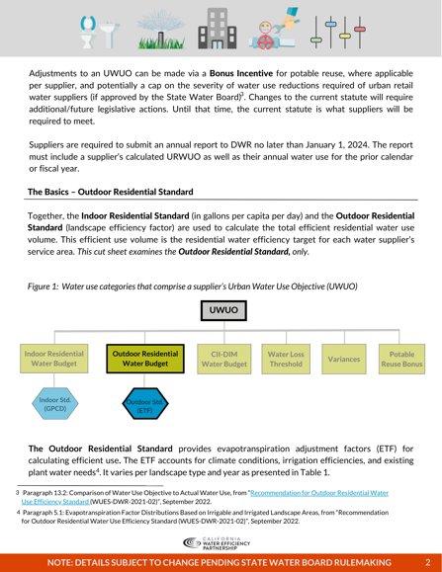
Coalition Partners: CalWEP
Tia Fleming
https://calwep.org/framework-updates/
https://calwep.org/resource/design-considerations-for-a-residential-leak-detection-repair-certification-training/
https://calwep.org/resource/the-outdoor-standard-cut-sheet/
https://calwep.org/event/peer-to-peer-2023/

Slide 20
Questions and Comments?
Chelsea Haines, Regulatory Relations Manager
Chelseah@acwa.com
Sonja Eschenburg, State Relations Assistant
Sonjae@acwa.com

