Slide 1
ACWA Bi-Monthly WUE Meeting
Making Water Conservation a California Way of Life
September 13, 2023
Contact Sonjae@acwa.com to be on the ACWA WUE Distribution lists

Slide 2
AGENDA
Welcome – Elizabeth Lovsted
Call to Action, Draft Reg, Process & Advocacy – Chelsea Haines
Regulatory Working Group Updates
General Regulation – Chelsea Haines
Outdoor Standard – Fiona Sanchez
CII Performance Measures – Ariel Flores
Methodologies – Elizabeth Lovsted
Data and Reporting – Nate Adams
Coalition Partner Update – CMUA, CWA, League of Cities WateReuse, CASA, CWA, CA-NV AWWA,

Slide 3
2. Call to Action, Process, Draft Reg & Advocacy
Aug. 18 – Formal Rulemaking
Oct. 4 – SWRCB Workshop/ Oral Comments
Oct. 17 – Written Comments Due
TBD – Revised Draft(s)
Summer 2024 –
Reg Adoption
Oct. 1, 2024 – Rule Becomes Effective, if Adopted
Regular Rulemaking Process – Admin. Procedures Act
Minimum of 45-day comment period – Oct. 17
Substantive changes (alters meaning of reg) – 15-day comment period before final is adopted

Slide 4
2. Call to Action, Process, Draft Reg & Advocacy
2 KEY DATES:
OCT. 4 – STATE WATER BOARD WORKSHOP
OCT. 17 – WRITTEN COMMENTS DUE
https://www.acwa.com/resources/making-conservation-a-way-of-life/

Slide 5
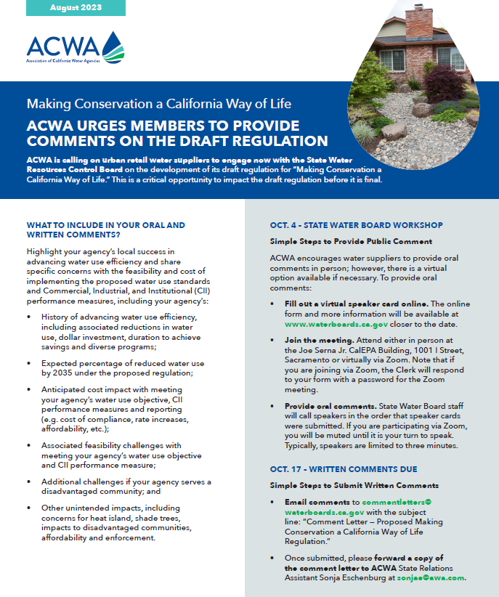
2. Call to Action, Process, Draft Reg, & Advocacy
Suppliers need to show
up and highlight:
Expected % Reduction
Expected Cost
Feasibility Challenges
DAC Community
Unintended Impacts
https://www.acwa.com/resources/making-conservation-a-way-of-life/

Slide 6
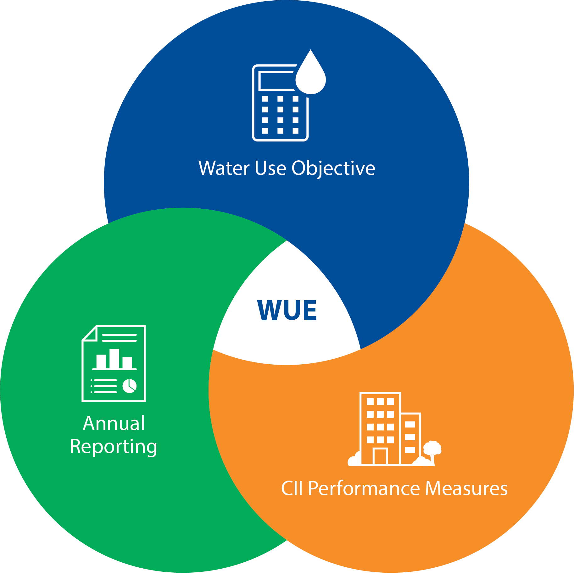
2. Call to Action, Process, Draft Reg & Advocacy
3 Key Components of Making Conservation a Way of Life Regulation:
Water Use Objective
Commercial, Industrial, Institutional (CII) Performance Measure
Annual Reporting
Compliance starts Jan. 1, 2024!!

Slide 7
2. Call to Action, Process, Draft Reg & Advocacy
1. Water Use Objective
Statewide Efficiency Standards for urban water uses
+
Unique local service area characteristics: population, climate and landscape area

Slide 8
2. Call to Action, Process, Draft Reg & Advocacy
Water Use Objective
How to Understand the Impact:
Review the Rulemaking material
including draft Reg Text and SRIA
Use the Water Use Objective Exploration Tool
Change defaults to proposed 2035 standard: Indoor to 42, Outdoor to 0.55, Landscape Area to O%
Review SWRCB Provision Data Released
Review your data for accuracy
Indoor Standard – Already adopted (SB 1157)
Outdoor Residential Standard – SWRCB will consider adoption in Reg
Outdoor CII DIM – SWRCB will consider adoption in Reg
Water Loss – Already adopted (SWRCB 2022 Water Loss Reg)
Variances - SWRCB will consider adoption in Reg

Slide 9
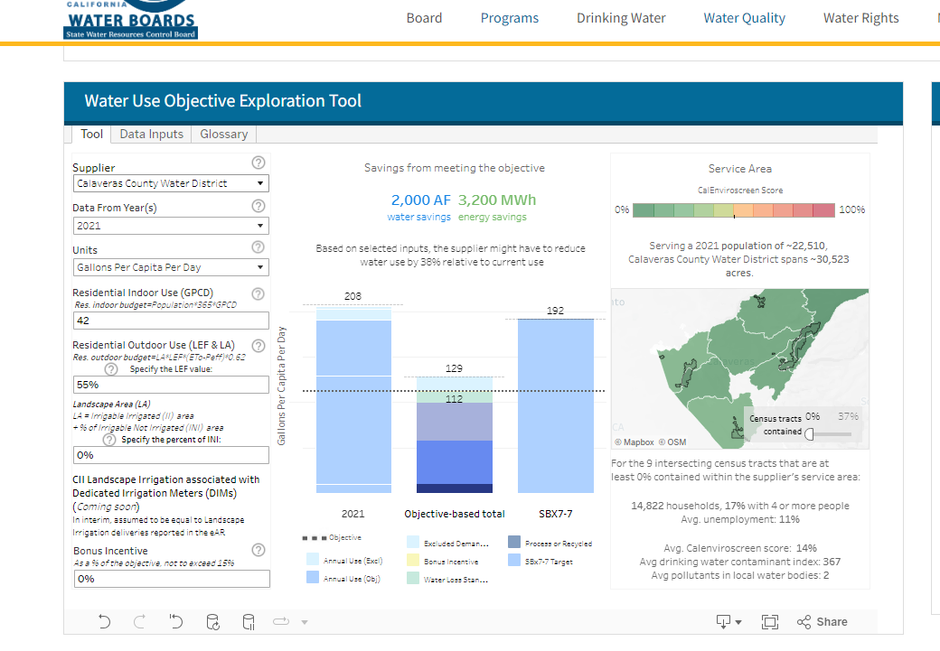
2. Call to Action, Process, Draft Reg & Advocacy
1. Water Use Objective - Go to: https://www.waterboards.ca.gov/water_issues/programs/conservation_portal/water-use-explorer/
Change Defaults to proposed 2035 standards:
Indoor to 42
Outdoor to 0.55
Landscape Area to O%
Review Reduction Required by 2035
Fact Check Agency Data:
Provisional Data

Slide 10
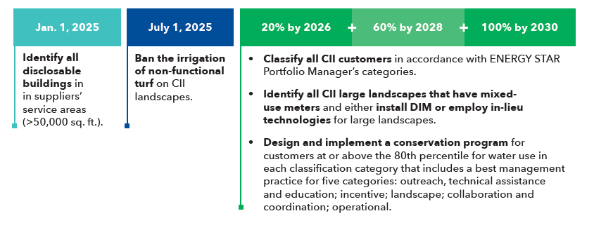
2. Call to Action, Process, Draft Reg & Advocacy
2. CII Performance Measures – compliance starting 2025

Slide 11
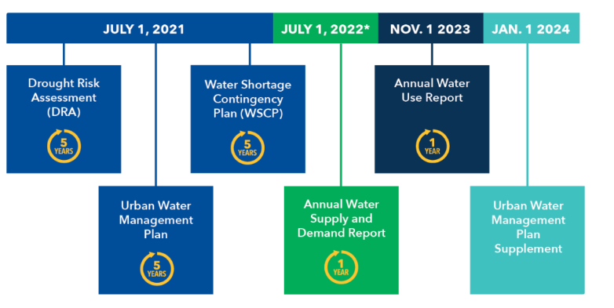
2. Call to Action, Process, Draft Reg & Advocacy
3. Annual Reporting – compliance starting 2024
Starting Jan. 1, 2024, and every year thereafter - Annual Reporting Requirements to the State Water Board that include suppliers:
Urban water use objective
The actual urban water use
Documentation of the implementation of CII performance measures
Description of progress made towards meeting the urban water use objective (§Water Code 10609.24)

Slide 12
2. Call to Action, Process, Draft Reg & Advocacy
“ACWA supports
California’s advancement of long-term efficient
and wise use of water in a manner that is
feasible, cost-effective and minimizes unintended impacts
to Californians communities.”
ACWA Meeting Schedule:
WUE Working Groups: WUE Overarching, WUE Outdoor, WUE CII Performance Measures, WUE Methodologies and Variances (email sonjae@acwa.com to join the distribution list).
ACWA Bi-Monthly WUE Meetings: Meetings are held on the second Wednesday of every other month from 10 a.m. to noon. To attend, visit www.acwa.com/events. Meeting dates: Sept. 13, 2023, Nov. 8, 2023, Jan. 10, 2024, March 13, 2024, May 8, 2024, July 17, 2024.

Slide 13
3. ACWA Working Group Update
Weekly Meetings Scheduled through Oct. 17:
Outdoor Standards
Monday from 3:00 – 4:00 pm
Chair: Fiona Sanchez
Methodologies, Variances & Reporting
Tuesday from 4:00 – 5:00 pm
Chair: Elizabeth Lovsted
CII Performance Measures
Thursday from 3:00 – 4:30 pm
Chair: Ariel Flores
Data (SWRCB Tool & Provisional Data)
Today, Sept. 14 from 4:00 – 5:00 pm
Chair: Nate Adams
To Join Working Groups:
Email Sonja Eschenburg at sonjae@acwa.com

Slide 14
3. ACWA Working Group Update - Outdoor
Residential Outdoor Standard
 | State Water Board Regulation Text | DWR Proposal ETF
2024- June 2030 | 0.8 ETF | 0.8 ETF
July 2030 – June 2035 | 0.63 ETF | 0.63 ETF
July 2035 on | 0.55 ETF | 0.63 ETF
Irrigable, not currently Irrigated (INI) | Up to 20% only if actual use is greater than the water use objective without it Only available through June 2027 | 20% of INI
Special Landscape Areas | 1.0 | 1.0
Residential Ag | 1.0 or Crop Factor from DWR | 1.0
New Development (post-2018) | Currently 0.55 Reference to MWELO | 0.55
Precipitation Adjustment (Reduction to ET) | Up to 25% | Up to 25%

Slide 15
3. ACWA Working Group Update - Outdoor
Residential Outdoor Standard
 | State Water Board Regulation Text | DWR Proposal ETF
Pools | Temporary Provision 2035-2040 = 0.08 Based on DWR 2022 data or alternative data, if equivalent or superior Public swimming pools (i.e. HOAs) Considered SLA = 1.0 | Same as landscape ETF for residential SLA = 1.0

Slide 16
3. ACWA Working Group Update - Outdoor
CII Dedicated Irrigation Meter
 | Dedicated Irrigation Meter ETF | DWR Proposal ETF
Through June 2028 | Equivalent to actual reported deliveries | 0.8 ETF
July 2028- June 2030 | 0.8 ETF | 0.8 ETF
July 2030 – June 2035 | 0.63 ETF | 0.63 ETF
July 2035 on | 0.45 ETF | 0.63 ETF
Special Landscape Areas (sports fields, functional turf, public pools, water features, etc.) | 1.0 | 1.0
Irrigated with Recycled Water | 1.0 Reference to MWELO Variance for high TDS | 1.0 Variance for high TDS
New Development (post-2018) | 0.45 Reference to MWELO | 0.45
Precipitation Adjustment (Reduction) | Up to 25% | Up to 25%

Slide 17
3. ACWA Working Group Update - Outdoor
CII – Non Functional Turf
Suppliers shall ban irrigation of non-functional turf with potable water on all CII landscapes by July 1, 2025

Slide 18
3. ACWA Working Group Update - Outdoor
Variances and Temporary Provisions
Recycled Water with high TDS
Approval of annual variance required to include special landscape areas
Water to supplement pools and lakes to sustain wildlife
Pools – existing pools, spas and water features (residential)
0.08 LEF
January 2035- January 2040
Climate ready trees
Establishment of qualifying landscapes

Slide 19
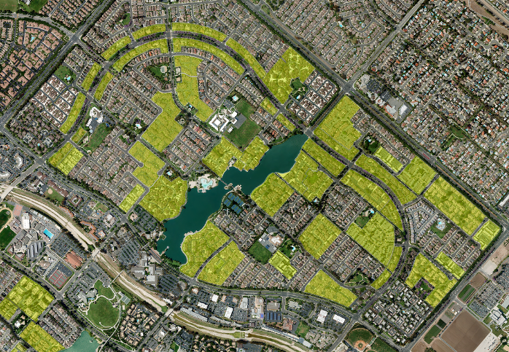
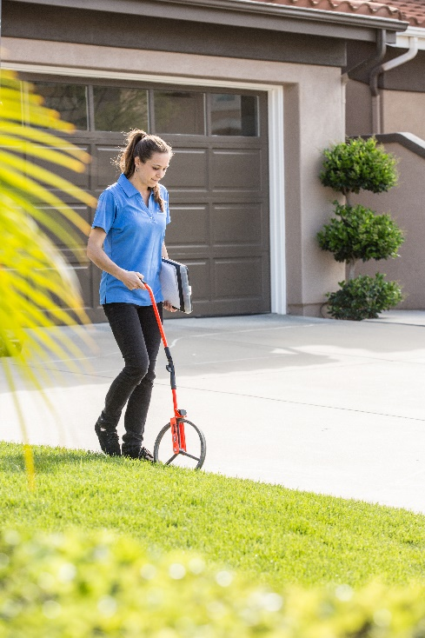
3. ACWA Working Group Update - Outdoor
Landscape Area Measurement
Residential: Landscape area provided by DWR or approved equivalent or superior data
Commercial Dedicated Irrigation Meters (DIMs): Supplier required to measure landscape square footage for CII DIMs by July 1, 2028
Mixed Use Meters: Landscape area to be generated by DWR and substantiated by the water supplier
Suppliers need to estimate water budget and use
Changes to accommodate growth and new development based on reported MWELO data

Slide 20
3. ACWA Working Group Update - Outdoor
Mixed Use Meters – Large Landscapes: Separate Meters or In-Lieu Technology
Install separate meters or employ in-lieu technologies for large landscapes
Annual outdoor usage estimated at 500,000 gallons or more (~1.5 AF)
For large landscapes without DIMs, suppliers must employ at least 2 of the following in-lieu technologies:
Water budget-based rate structure
Water budget-based management program without a rate structure
Hardware improvements - i.e smart irrigation controllers, pressure-regulated spray heads, metering technologies etc.
Remote sensing
Landscape plant transformation programs
Other water efficient technologies that improve water efficiency
Supplier also shall employ following water management practices for large landscapes without DIMs:
Communications
Irrigation systems maintenance
Irrigation scheduling
Year | Percent Compliance
2026 | 20%
2028 | 60%
2030 | 100%
After 2030 | At least 95% based on annual assessment

Slide 21
3. ACWA Working Group Update - Outdoor
2035 - 5 Year Implementation Extension
Suppliers my use the 2030 outdoor standards until 2040, if:
Meet income threshold (<80% median household income in CA) or
Requirements: Shows average of 2% reduction, shows to satisfaction of the Board unable to meet
Required reduction of 20% of more
requirements: Compliance with G480 AWWA, Tree City USA recognition, dedicated program for climate ready landscapes (0.1% turf conversion, dedicated staff, 40% of funding to low-income households
Significant additional program implementation, funding, staffing and cost-allocation requirements if based on required reduction percentage

Slide 22
3. ACWA Working Group Update – CII
CII BMPS for High Water Usage Customers
Identify “disclosable” buildings in service area by January 1, 2025 and provide customer usage information to customer according to timeline
Ban irrigation of non-functional turf with potable water for CII landscapes - July 1, 2025

Slide 23
3. ACWA Working Group Update – CII
CII Classification
CII Classifications:
Banking/ Financial Services
Education
Entertainment/ Public Assembly
Food Sales & Services
Healthcare
Lodging/ Residential
Manufacturing/ Industrial
Mixed Use
Office
Parking
Public Services
Religious Worship
Retail
Technology/ Science
Utility
Warehouse/ Storage
Other
CII Laundries
Large Landscapes
Water Recreation
Car Wash & Secondary Uses
Classify all CII customers - 18 ENERGY STAR Categories + 4 additional categories
Proposed Timeline:
20% accounts by 2026
60% accounts by 2028
100% accounts by 2030

Slide 24
3. ACWA Working Group Update – CII
MUM Conversion Threshold & In-Lieu Technology
Identify CII Customers with large landscapes using >500,000 gallons/year
Install Dedicated Irrigation Meter or
Implement In-Lieu Technology
Proposed Timeline:
20% accounts by 2026
60% accounts by 2028
100% accounts by 2030

Slide 25
3. ACWA Working Group Update – CII
CII BMPS for High Water Usage Customers
Design & implement conservation programs for high usage customers that includes following type of BMPs according to timeline:
Outreach, Technical Assistance & Education
Incentive
Landscape
Collaboration & Coordination
Operational
Timeline:
20% accounts by 2026
60% accounts by 2028
100% accounts by 2030

Slide 26
3. ACWA Working Group Update – Methodology
Overview
High Level Concerns:
Limited flexibility in compliance
Proposed alternative is not feasible and has very narrow application parameters
Variances are limited and require data intensive analysis
Solutions:
Allow a 20 percent buffer for compliance to account for data
Water suppliers are considered compliant if actual water use is within 120 % of calculated objective.

Slide 27
3. ACWA Working Group Update – Methodology
Overview
Water suppliers whose actual water use is 120% or greater than objective will have considered to have put in a good faith and in compliance with the regulation if they can demonstrate:
The availability of a comprehensive water use efficiency program that includes outreach, education and incentive to reduce residential and DIM water use.
At least an average of a 2% reduction in gpcd water user since 2013
Prior to issuing conservation orders or fines due to a supplier’s actual water use being greater than 120% of the objective, the SWRCB shall:
Assist with analyzing the applicability and calculating any potential variances.
Work with the water supplier to identify why WUE programs are not meeting WUE goals.
Offer resources and funding

Slide 28
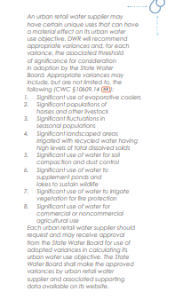
3. ACWA Working Group Update – Methodology
Variances
Allow all variances if total impact is greater than 5% or if water supplier is within 5% of compliance
Variances once approved should be valid for a minimum of 5 years.
Variances will be considered approved within 90 days of submittal unless supplier receives justification for denial from SWRCB

Slide 29
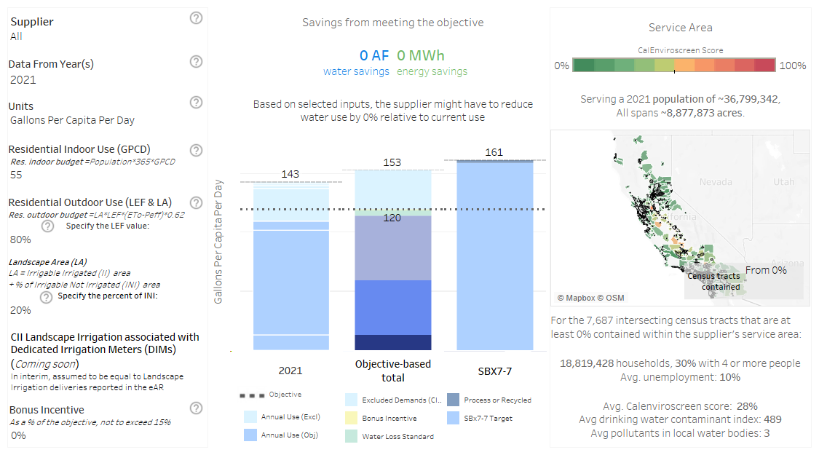
3. ACWA Working Group Update – Data
Water Use Efficiency Exploration Tool & Provisional Data
Known issues:
Inaccurate indication of compliance
DIM required reductions are not shown
Check population (indoor budget)
Indivual Years vs. Average years make compliance look much different
Compares to Total Water Use (not water included in WUE Objective
State Water Board WUE Reg Website – Contains
“Explorer Tool” &
Provisional Dataset (Excel)

Slide 30
4. Coalition Partners
CMUA, Andrea Abergel
CWA, Jennifer Capitolo
League of Cities, Melissa Sparks-Kranz
WateReuse, Rosario Cortes
CASA, Jared Voskuhl
CA-NV AWWA, Sue Mosburg

Slide 31
Chelsea Haines Regulatory Relations Manager Chelseah@acwa.com
Making Water Conservation a California Way of Life
September 13, 2023
Contact Sonjae@acwa.com to be on the ACWA WUE Distribution lists

