Slide 1
Water Use Efficiency Work Group
Bi-Monthly Meeting
October 12, 2022
10:00 AM – 12:00 PM

Slide 2
Meeting Agenda
October 12, 2022  10:00 AM – 12:00 PM
Chair Welcome – Elizabeth Lovsted
Drought Update – Chelsea Haines
Legislative Updates – Julia Hall
Indoor WUE Objective
Turf Replacement Rebate Tax Exemption
Water Use Objective Updates
Water Loss – Amy Talbot
DWR Recommendation: Outdoor Standard – Fiona Sanchez
DWR Recommendations: CII Performance Measures – Elizabeth Lovsted
Variances – Elizabeth Lovsted
ACWA Working Groups & Next Steps – Chelsea Haines
CA-NV AWWA – Amy Talbot

Slide 3
Drought Update: State’s Response
Chelsea Haines
CA Water Supply Strategy – Aug 2022
Goal 1: Develop New Water Supplies
Goal 2: Expand Water Storage Capacity Above and Below Ground by 4 MAF
Goal 3: Reduce Demand
Goal 4: Improve Forecasting, Data, and Management, Including Water Rights Modernization
3.1 Build upon conservation achievements over the last two decades to reduce annual water demand in towns and cities by at least 500,000 maf by 2030.
SWRCB to develop short-term efficiency-based conservation targets for every urban retail water suppliers based on their unique characteristics like climate zone, water demand, residential landscape area, and population. The Board will compare water suppliers’ actual use to their estimated efficient use target and assign them a percent reduction, with a higher target for suppliers’ whose actual use is further from their efficient use target.
The State Water Board will advance adoption of new long-term water use efficiency standards, per existing statute (2018).
Once DWR provides its formal recommendations, the State Water Board will begin the process for enacting the regulation to ensure the rule will be in effect by January 1, 2024.

Slide 4
Legislative Updates
Julia Hall
AB 2142 (Gabriel, D-Encino) Income Taxes: Exclusion: Turf Replacement Water Conservation Program
Taxable years 2022 through 2026
Gross income does not include any amount received a rebate, voucher or other financial incentive issued by a public water system, local government or state agency for participation in a turf replacement water conservation program
Legislative text

Slide 5
Legislative Updates
Julia Hall
SB 1157 (Hertzberg, D-Van Nuys) – Urban Water Use Objectives: Indoor Residential Water
2025 standard = 47 gpcd; 2030 standard = 42 gpcd
DWR, in coordination with the SWRCB, to conduct necessary studies and investigation to assess and quantify the economic benefits and impacts of the 2030 indoor standard on water, wastewater and recycled water systems and shall include saturation end-use studies
DWR to summarize findings of studies and investigation to Legislature by Oct. 1, 2028
Based on studies and investigations, DWR may recommend an extended timeline for the 2030 standard or potential variances specific to the indoor standard, including: stranded assets, impacts on DACs, impacts to environmental flows, adverse impacts to wastewater or recycled water operations
Legislative Text Here
Signing Message Here

Slide 6
WUE Objective Update: Schedule & Status
Elizabeth Lovsted
Components | Recs/ Draft Available | Final Approved
Indoor Residential WUE Standard | Yes – 11/30/21 | Yes – 9/28/22
Water Loss Standard | Yes – 9/2/22 | *10/18/22
Outdoor Residential WUE Standard (ORWUS) | Yes – 9/29/22
WUE Standards for CII Outdoor Irrigation of Landscape Area with Dedicated Irrigation meters | Yes – 9/29/22
Variances for Unique Uses of Water | No
CII Water Use Performance Measures | Yes – 9/29/22
Guidelines and Methodologies for Calculating Urban Water Use Objectives | No
UWMP and WSCP Guidelines | Yes | Yes – 3/21

Slide 7
WUE Objective Update: DWR Recommended Outdoor Standards
Fiona Sanchez
Irrigated Area and Water Source | Residential | Dedicated Irrigation Meter (DIM)
Irrigated (II) – potable | 2023-2030: 0.8 2030 on: 0.63 | 2023-2030: 0.8 2030 on: 0.63
Irrigable, not currently Irrigated (INI) May be adjusted based on future studies | 20% of INI 2023-2030: 0.8 2030 On: 0.63 | No INI component
Special Landscape Areas Sports fields, functional turf Irrigated with Recycled Water | 2023-2030: 0.8 2030 On: 0.63 | 1.0
New Construction and Rehabilitated Landscapes (post Jan 1, 2020) | 0.55 | 0.45
Landscape Area Measurement | Provided by DWR May be adjusted with water supplier data | Suppliers to identify and complete measurements within 5 years after adoption

Slide 8
WUE Objective Update: Outdoor Standards
Fiona Sanchez
Additional SLAs for CII Dedicated Irrigation Meters
Bioengineered slopes
Public swimming pools
Supplemental water for ponds or lakes, including sustaining wildlife, recreation or other public benefits
Exempt Landscapes: exempt landscapes in Gov. Code 65598 and 2015 MWELO
Cemeteries
Registered historical sites
Ecological restoration projects that do not require permanent irrigation
Botanical gardens and arboretums open to the public
Effective Precipitation
Would reduce outdoor budget by up to 25%
Not addressed in recommendations to State Board, but previously incorporated into DWR’s proposed calculation formula

Slide 9
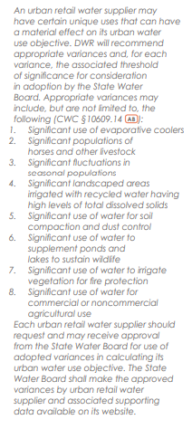
WUE Objective Update: Variances
Elizabeth Lovsted
Recommendations on Variances for Unique Water Uses
The details containing the threshold of significance used will be provided in the full recommendation reports.
Sufficient evidence supports the establishment of the eight variances identified in the 2018 Legislation
2 should be refined: dust control limited to horse corals; irrigate vegetation for fire protection modified and expanded to during major emergencies
Add variance for significant use of water for home use medical devices – consider further

Slide 10
WUE Objective Update: CII Performance Measures
Ariel Flores
Recommendations on CII Water Use Performance Measures
CII Water Use Classification System
19 categories of water uses
Complete classifications within 5 years from SWRCB adoption
DWR to provide technical assistance and develop guidance for CII mapping
CII Conversion Threshold
1 acre of landscape area irrigated by a mixed-use meter on a per parcel basis
Complete landscape area measurement and determine if a dedicated meter (or equivalent technology) or in-lieu technologies will be implemented within 5 years from SWRCB adoption
In-Lieu Technologies
Includes: (1) Water budget-based rate structures, (2) Water budget-based management without a rate structure, (3) Hardware improvements with enhanced performance, (4) Remote sensing combined with other data and hardware improvements, (5) Landscape plant palette transformation programs, (6) Others as approved by the State Water Board
Complete landscape in-lieu technologies within 5 years after the first year of landscape measurement under the conversion threshold PM

Slide 11
WUE Objective Update: CII Performance Measures (cont.)
Ariel Flores
Recommendations on CII Water Use Performance Measures
CII Best Management Practices, Performance Measure, and Threshold for Implementation
Selection of specific CII water user BMPs is subject to local determination
Design CII-BMP implementation program specific to service area that includes:
Threshold of significant are 1) CII water use sector that comprise the top 20 percent of all CII water use, and 2) individual top 2.5 percent of CII water users, excluding process water
At least 1 CII from 5 recommended categories (outreach, technical assistance and education, incentives, landscape, collaboration and coordination, operational)
Supported with documentation demonstrating increased water use efficiency
Complete program development within 3 years after SWRCB adoption

Slide 12
WUE Objective Update: Bonus & Guidelines
Elizabeth Lovsted
Recommendations for Bonus Incentive, Methods of Calculation, and Supporting Data Requirements
Option 2a with some modification – Last-In-First-Out inclusive of Water Loss Criteria Methodology
Uses delivered amounts of potable recycled water to qualified end uses that implicitly include consideration of system losses
Deferred under SWRCB adopts criteria and regulations for DPR permitting requirements
Recommendations on Guidelines and Methodologies for Calculating UWUO
The comprehensive guidelines and methodologies are contained in the full recommendation report
Compliance with 2020 SB X7-7 Target
Must maintain water use below SB x7-7 targets

Slide 13
WUE Objective Update: Water loss
Amy Talbot
Recent Comment Periods
February 2022 – Primary
September 2022 – Secondary
Regulation/Economic Model
Coalition Comment Letters to discuss concerns – some still remain
Changes Achieved:
Ongoing adjustments beyond 2023 to recognize and incentivize data quality improvements.
A compliance pathway for real water loss if a supplier’s water loss standard is lower than the supplier’s average baseline real loss by 30% or more.
Guidance and process for submitting supplier-specific input data for the economic model.
Supplier templates for apparent loss inventory and leak registry submissions.
Clarified terms, including ICF, apparent and real loss, and leakage definitions.
Time extension consideration for newly consolidated systems.
Flexibility for meter testing requirements for suppliers considering the offramp option.
Exemption for some small systems (remaining related concerns described above).
Leak registry reporting required every three years instead of annually (remaining related concerns described above).

Slide 14
WUE Objective Update: Water loss
Amy Talbot
Next Steps
Presented for approval at the October 19th SWB Board meeting (noon)Posted agenda, item detail and draft resolution for approval SWB Water Loss Webpage: https://www.waterboards.ca.gov/water_issues/programs/conservation_portal/water_loss_control.html
Updated regulation text to be posted soon
No substantive changes from the September 2nd draft
Stakeholder comments at Board meeting
Expect adoption next week
PLEASE CHECK YOUR WATER LOSS TARGET/STANDARD

Slide 15
ACWA Next Steps
Chelsea Haines
ACWA Current WUE Working Groups
WUE Overarching – Chair: Elizabeth Lovsted
Water Loss Working Group – Chair: Amy Talbot
Indoor WUE Working Group – Chair: Amy McNulty
Outdoor Working Group – Chair: Fiona Sanchez
CII BMPs Working Group – Chair: Ariel Flores
Looking to 2023…
Variances
Bonuses
Guidelines and Methodologies
ACWA Conference Program: Thursday, Dec. 1 @ 2:15

Slide 16
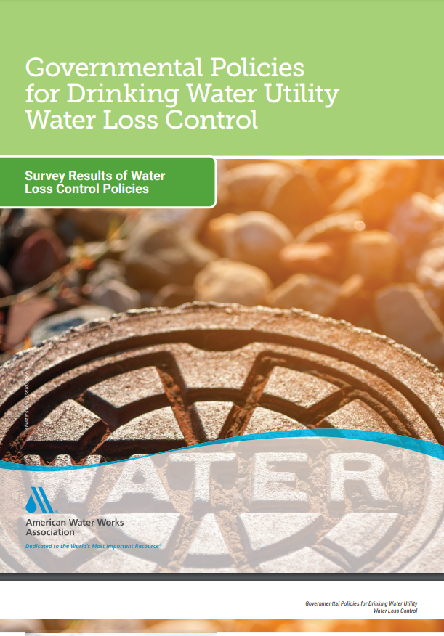
WUE Objective Update: CA-NV AWWA
Amy Talbot
AWWA released the “Governmental Policies for Drinking Water Utility Water Loss Control – Survey Results of Water Loss Control Policies” Resource
In 2021, AWWA’s Technical and Educational Council again funded a survey of North American government agencies (state, provincial, and regional) to document
Policies that agencies are implementing in their jurisdictions and how they are measuring success, mostly regarding water audit methods and results, and
Information that agencies can use to better assess the water loss control needs of utilities within their jurisdiction and develop, implement, and evaluate effectiveness of policies intended to help meet these needs.
Document link here:
https://www.awwa.org/Portals/0/AWWA/ETS/Resources/Technical%20Reports/35392%20Governmental%20Policies_FINAL.pdf?ver=2022-09-08-150806-283

Slide 17
Questions and Comments?
Chelsea Haines, Regulatory Relations Manager
Chelseah@acwa.com

