Slide 1
Water Use Efficiency Work Group
Bi-Monthly Meeting
October 20, 2021
10:00 AM – 12:00 PM

Slide 2
Meeting Agenda
October 20, 2021  10:00 AM – 12:00 PM
Chair Welcome – Elizabeth Lovsted
Drought Update – Chelsea Haines
DWR Updated Schedule – Elizabeth Lovsted
Related Legislative Proposal – Julia Hall
Urban Water Use Efficiency Updates – Elizabeth Lovsted
Indoor Standard – Elizabeth Lovested
Outdoor Water Budget Development & Implementation - Fiona Sanchez
Commercial, Industrial and Institutional Standards - Ariel Flores
Water Loss Performance Standards - Amy Talbot
Variance and Bonus – Nicholas Schneider
Electronic Annual Report – Chelsea Haines

Slide 3
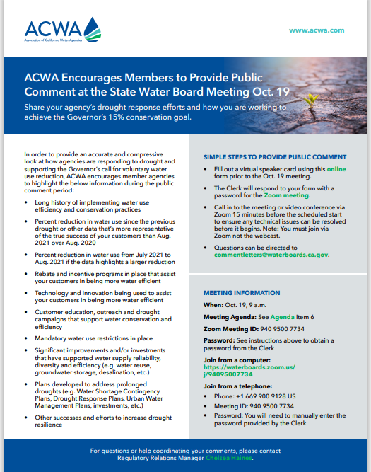
Drought Update
Chelsea Haines
Executive Order N-10-21 (July 8)
50/ 58 counties
Voluntary Conservation 15% from 2020 levels
State Water Board Meetings (2nd meeting of the month)
Sept. – July 2021 1.8%
Oct. 19 -
ACWA Efforts
Sept 15 – webinar with Secretaries
ACWA Drought Webpage
Op-Eds
Drought State Funding
Drought.ca.gov
Grants.ca.gov

Slide 4
Drought Update
Chelsea Haines
Oct. 19, 2021 – Proclamation of a State of Emergency
Expands to all counties
Water transfer requests
State assistance with drinking water shortages
Local water supplies to execute Urban Water Shortage Contingency Plan and Ag. Drought Plans at a level appropriate to local conditions that takes into account the possibility of a third consencutive dry year. Ensure UWMP & AWMPs are up to date.
SWRCB emergency regulations for certain wasteful practices
CDFA to recommend ag. efficiencies
OES to provide assistance for temporary emergency supply, delivery, or both of drinking water or water for sanitation purposes.
CEQA Suspension – water transfers,

Slide 5
DWR Updated Schedule
Elizabeth Lovsted
Component | Timing | Lead Agency
Permanent monthly reporting | Since Oct. 1, 2020 | SWRCB
Water loss standards | End of 2020 ? | SWRCB
Recommendation on indoor standards | January 2021 2021 | DWR
Residential irrigable land measurements | January 2021 ? | DWR
Recommendation on WUE standards* | October 2021 Nov. 16/17 | DWR
UWMP/WSCP updates | July 2021 | DWR
Adoption of WUE standards* | July 2022 | SWRCB
Annual water shortage assessment | June 2022 | DWR
*WUE standards include:
Outdoor residential use standard
Standard for CII outdoor landscape area with dedicated irrigation meters
Performance measures for CII water use
Appropriate variances
Guidelines and methodologies for calculating urban water use objectives

Slide 6
Urban Water Use Efficiency Updates
Elizabeth Lovsted
Upcoming DWR Dates:
Oct. 20 from 10:00 – 12:00 PM – ACWA Bi-Monthly WUE Meeting – ACWA to recap the State’s efforts to date to implement the Making Water Conservation a California Way of Life framework and ACWA’s policy and technical priorities. Visit the link for meeting details.
Oct. 25, 9:00 AM – 12:00 PM – DWR Workshop: Outdoor and CII Standards – DWR to provide update and solicit input on (1) outdoor water use standard, and (2) CII outdoor landscape area with dedicated irrigation meters standards. Click the following link for remote participation.
Nov. 16, 9:00 – 12: 00 PM – DWR Workshop: Water Supply and Demand Assessment – DWR to provide guidance for the Annual Water Supply and Demand Assessment (AWSDA). DWR will solicit input on the two key components of the AWSDA: (1) annual water shortage assessment guidance and reporting template, and (2) examples of water supply and demand assessment procedures to inform the annual water shortage assessment reporting. DWR will email out the draft guidance in early November ahead of the meeting. Click the following link for remote participation.
Nov. 16, 1:00 – 4:00 PM – DWR Workshop: Outdoor and CII Recommendations – DWR to present final draft recommendations (1) outdoor use standard, and (2) CII outdoor landscape area with dedicated irrigation meters standards. Click the following link for remote participation.

Slide 7
Urban Water Use Efficiency Updates
Elizabeth Lovsted
Upcoming DWR Dates:
Nov. 17, 9:00 AM – 12 PM, 1:30 PM – 5:00 PM – DWR Workshop: Draft Recommendations – DWR to present final draft recommendations for (1) Variances, (2) CII Water Use Classification System, (3) Bonus Incentives. Present final draft recommendations on guidance and methodologies. Click the following link for remote participation.
Dec. 2, 1:00 – 3:00 PM – SWRCB Public Workshop: Wastewater Management – State Water Board to provide a detailed overview of the methods being used to evaluate potential impacts of the water use efficiency standards on local wastewater management, developed and natural parklands, and urban tree health. Click the following link for remote participation.
Dec. 3, 1:00 – 4:00 PM – SWRCB Public Workshop: Urban Trees and Parklands – SWRCB to provide a detailed overview of the methods being used to evaluate potential impacts of the water use efficiency standards on local wastewater management, developed and natural parklands, and urban tree health. Click the following link for remote participation.

Slide 8
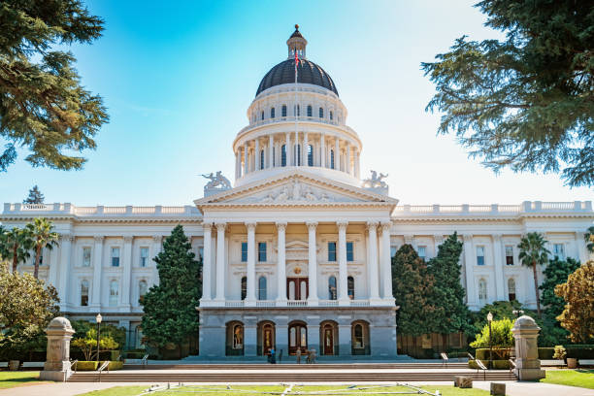
Related Legislative Proposals
Julia Hall
Potential Legislation for 2022
AB 1434 (Freidman) Urban water use objectives: indoor residential water use
Potential ACWA Legislative Proposal re: Indoor
Potential Co-Sponsored Proposal with EMWD re: Nonfunctional Turf

Slide 9
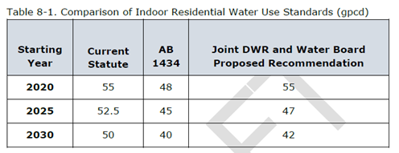
Indoor Residential Water Use Standard
Chelsea Haines
April 22 - DWR shared preliminary recommendations
May 4 – ACWA met with DWR Executive Director Nemeth to discuss concerns that DWR has not collaborated with stakeholders and analyzed impacts to water and wastewater management
May 10 – DWR released the “Public Review Draft Report to the Legislature on Results of the Indoor Residential Water Use Study”
May 21 – DWR held additional working group and public workshop w/ ACWA input on agenda

Slide 10
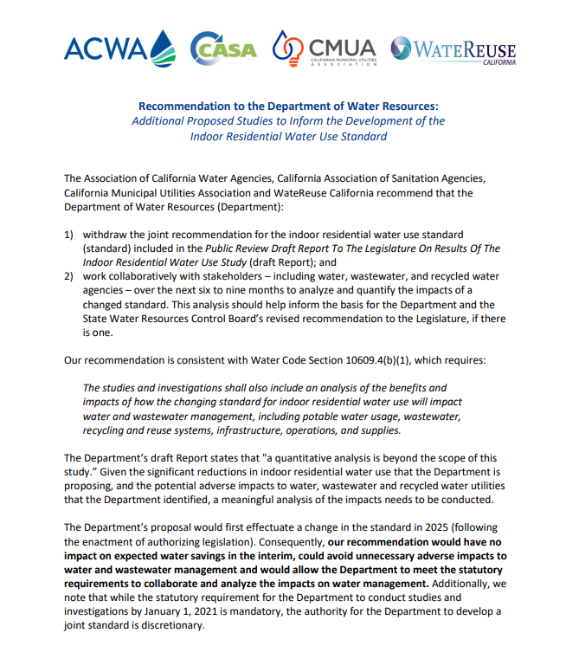
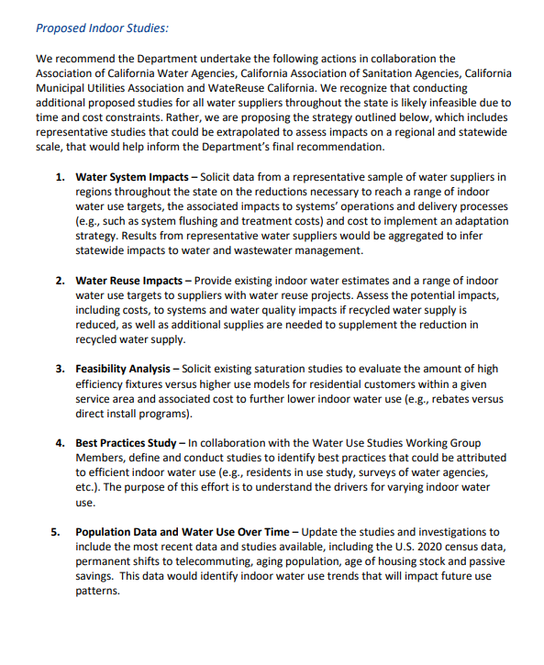
Indoor Residential Water Use Standard
Chelsea Haines
FINAL REPORT EXPECTED ANYTIME!
Expected to include:
Table 8.1 DWR/ SWRCB Proposed Recommendations
Appendix of Stakeholder Comments
ACWA Concerns:
Legislative requirements not met:
Analyze impacts of a changed standard: operational, cost, feasibility, affordability
Broader Context of Making Water Conservation a California Way of Life
Population and COVID-19 data
Proposed 5 Additional Studies
Notes:
10609.4 (b) (1) The department, in coordination with the board, shall conduct necessary studies and investigations and may jointly recommend to the Legislature a standard for indoor residential water use that more appropriately reflects best practices for indoor residential water use than the standard described in subdivision (a). A report on the results of the studies and investigations shall be made to the chairpersons of the relevant policy committees of each house of the Legislature by January 1, 2021, and shall include information necessary to support the recommended standard, if there is one. The studies and investigations shall also include an analysis of the benefits and impacts of how the changing standard for indoor residential water use will impact water and wastewater management, including potable water usage, wastewater, recycling and reuse systems, infrastructure, operations, and supplies.
DWR identified 9 Adverse Impacts with the Changed Standard: (1) Deterioration of water quality, (2) Stranded assets and stagnation in storage facilities, (3) Reductions in revenue from reduced water sales, (4) Increased sewer gas production, (5) Accelerated rate of corrosion in sewer pipes and manholes (6) Increased occurrence of sewer blockages and overflows, (7) Degradation of wastewater influent quality, (8) Reductions in recycled water quantity, (9) Deterioration of recycled water quality

Slide 11
Outdoor Water Use Standard
Fiona Sanchez
OUTDOOR STANDARD (CCF)
(Annual Reference Evapotranspiration(ETo)) x (Landscape Area) x
(Evapotranspiration Adjustment Factor (ETAF))/1200
Landscape Area
Residential LAM correction to DWR – June 30, 2021
DWR to finalize Residential LAM Data – August 30, 2021
ET Adjustment Factor:
0.7 ET Factor for Irrigated Landscapes
1.0 ET Factor for Special Landscape Areas (sports fields, recycled water)
0.7 ET Factor for 20% of Irrigable, not currently irrigated (INI)
0.55 ET Factor for new development
Assumed Irrigation Efficiency of 0.8

Slide 12
Outdoor Water Use Standard
AB 1668/ SB 606
LEGISLATIVE REQUIREMENTS
ACWA Concerns with DWR Proposal:
The Proposed 0.7 ET Factor does not support healthy and existing landscapes, including trees
Assumption of 80% Irrigation Efficiency is not feasible/possible
Existing data and research should support the proposed outdoor standard
Policy decision to use MWELO (a design standard) instead of real-world landscape performance and water needs. Majority of properties in California not subject to MWELO – constructed before 1993
Should not incorporate adjustment for precipitation
10609.6 (a)(2)(A) - The standards shall incorporate the principles of the Model Water Efficient Landscape Ordinance
10609.9 - Principles of MEWLO means those provisions of MWELO applicable to the establishment or determination of the amount of water necessary to efficiently irrigate both new and existing landscape

Slide 13
Outdoor Water Use Standard
Agency / Organization | Spray Head DU (avg) | Rotating Nozzle DU (avg) | Notes
MWDOC | 0.55; 0.58 | N/A | Average DU at 1,014 Residential sites; 1,106 Commercial sites
Coachella Valley Water District | 0.58 – 0.60 | 0.62 – 0.65 | DU catch-can results from sites with different sprinkler-types
 | 0.50 | N/A | DU ranges from 0.40 – 0.70
 | 0.55 | 0.68 | Range of sites throughout CA, retrofitting existing spray to new rotating nozzles
East Bay MUD | 0.48 | 0.69 | Retrofit program results of site going from spray to rotating nozzles.
Expected Distribution Uniformity by Sprinkler Type
Sprinkler Type | Achievable | Target | Historical
Rotary Nozzle | 0.75 – 0.85 | 0.65 – 0.75 | 0.55 – 0.65
Spray Sprinklers | 0.65 – 0.75 | 0.55 – 0.65 | 0.45 – 0.55

Slide 14
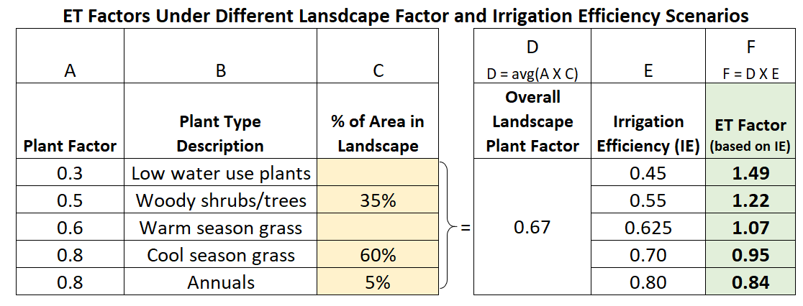
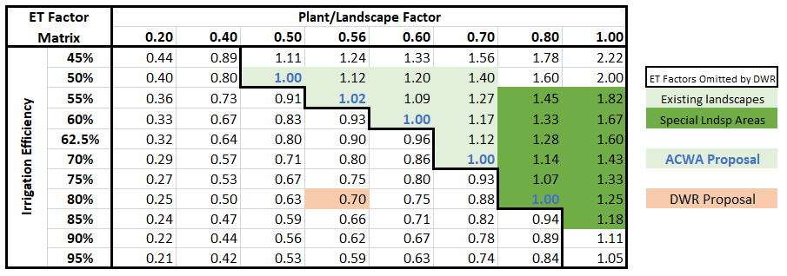
Outdoor Water Use Standard
Chart calculates the overall landscape plant factor (column D) and the ET Factor (column F) is based on different Irrigation Efficiency values (column E)

Slide 15
Outdoor Water Use Standard
Residential LAM Data
Variance Process
State Water Resources Control Board review and approval
Timing and process still to be determined
How will the application of variances be incorporated into DWR analysis of proposed outdoor factors?
Use of Alternative Data:
Process and timing to be determined by DWR
How will alternative data use be incorporated into DWR analysis of proposed outdoor standard?
Section 10609.20 (2): An urban retail water supplier may use alternative data in calculating the urban water use objective if the supplier demonstrates to the department that the alternative data are equivalent, or superior, in quality or accuracy to the data provided by the department.

Slide 16
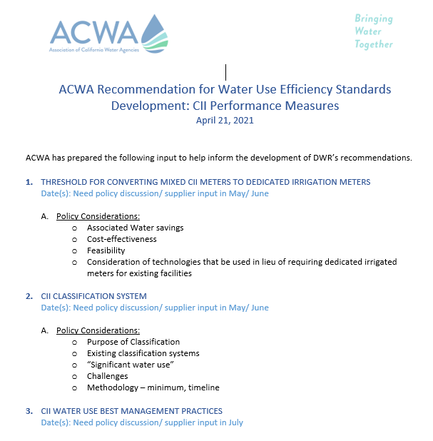
CII Performance Measures
Ariel Flores
ACWA Standard Development Recommendations to DWR (presented 4/21)
Threshold for Converting Mixed CII Meters to Dedicated Irrigation Meters
CII Classification System
CII Water Use Best Management Practices
Draft Performance Measures

Slide 17
CII Performance Measures
ACWA Recommendation for CII Performance Measures Conversion of Mixed CII Meters
Performance measures should achieve water savings and be cost-effective
Concerns & challenges of converting CII mixed-use meters to split
Failure to Guarantee Water Savings
Cost-Effectiveness of Water Savings
Complex Implementation
ACWA’s Recommended Approach
Recognize Conversation to Split Meter as a Best Practice & Prioritize Dedicated Irrigation Meters for New CII Development
Recommend Prioritizing In-lieu Technologies for Existing CII Facilities

Slide 18
CII Performance Measures
ACWA Recommendation for CII Classification System
No. | Main | Category | Description
1 | Commercial | 1a. Office | Any office building with or without Cooling Towers
 |  | 1b. Retail Stores/ Services | Any retail stores/ services of wet and dry food market
 |  | 1c. Warehouse and Storage (Non-Temperature Controlled) | Any warehouse or storage building with non-perishable items (clothing, toys, etc)
 |  | 1d. Food Sales and Service | Any food service or restaurants (full service or non-full service)
 |  | 1e. Hotels and Lodgings | Any Hotels, Motels, extended stay, etc
 |  | 1f. Athletic Clubs and Gyms | Any Athletic Clubs (YMCA…etc) and Gyms (Planet Fitness, 24 Hr Fitness)
 |  | 1g. Theme Parks and Recreational Water Facilities | Any Theme Parks (Disneyland, Knotts Berry farm Water Facilities (Raging Waters…)
 |  | 1h. Entertainment/ Public Assembly | Any Concert Halls, Movie Theater, etc
 |  | 1i. Vehicle Wash (Automatic, Auto Detailer) | Any auto Car wash or Car wash with detailing
 |  | 1y. Mixed Commercial (For meters with multiple connections) | Any Commercial facility with multiple connections on one (1) meter account
 |  | 1z. Miscellaneous - Commercial | Any Commercial facility that does not fit the description of the above categories
2 | Industrial | 2a. Industrial (Manufacturing and Product Research facilities) | Any Industrial Manufacturing and Product research (Food, Beverage, Pharmaceutical other industrial products)
 |  | 2b. Warehouse and Storage (Temperature Controlled) | Any Storage Warehouse that uses Cooling systems for Temperature controlled or perishable products
 |  | 2c. Industrial Laundry and other laundry facilities | Any fabric cleaning (Uniform and Linen Supply, Washers and Dry Cleaners and Coin washers)
 |  | 2y. Mixed Industrial (For meters with multiple connections) | Any Industrial facility with multiple connections on one (1) meter account
 |  | 2z. Miscellaneous - Industrial | Any Industrial facility that does not fit the description of the above categories
3 | Institutional | 3a. Education (Universities, Colleges, HS, Elem, Pre-school) | Any Universities, Colleges, Educational facilities (HS, Elementary, Pre-school)
 |  | 3b. Healthcare (Hospitals, Clinics, Lab facilities) | Any Hospitals, Medical Clinics, Dental Offices, Medical and Laboratory Services
 |  | 3c. Government & Utilities (Federal, State, County, City) | Any Govt Agency Offices, Prisons, Correctional. Any Water District, Gas Power Supply, Electricity Power Supply Companies, & Solid Waste
 |  | 3y. Mixed Institutional (For meters with multiple connections) | Any Institutional facility with multiple connections on one (1) meter account
 |  | 3z. Miscellaneous - Institutional | Any Institutional facility that does not fit the description of the above categories

Slide 19
CII Performance Measures
ACWA Recommendation for Best Management Practices
Recognize water supplies’ limitations in requiring and enforcing CII customers to participate in performance measures
Clarify how DWR will recognize suppliers' existing water use efficiency programs and BMPs, including previous water use surveys and other customer engagement activities.
Consider the feasibility for water suppliers of differing sizes and resources to conduct audits and WMPs. Mandatory thresholds for supplies to conduct audits and WMPS may create infeasible burdens on agencies.
DWR should provide guidance to suppliers on water savings recommendations to provide to customers that are audited.
Recognize high water use that is efficient vs. high water use that is wasteful - top water users can be efficient despite using larger volumes of water.
Align with the proposed CII classification system

Slide 20
Water Loss Performance Standards
Amy Talbot
March 2018 – May 2020 – Stakeholder meetings
May 2020 – Draft economic model, questionaries, policy documents
December 2020 – Revised economic model, revised policy
March 2021 – Peer Review
April 2021 – Updated Economic Model
Revised economic model
Formal Rulemaking expected in June 2021 ☺
Updates to model defaults submitted to SWRCB
Winter 2021 – Formal Rulemaking????

Slide 21
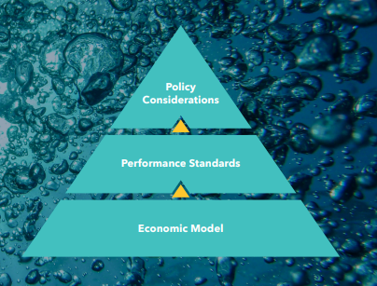
Water Loss Performance Standards
ACWA Remaining Concerns: 3 areas
Compliance
Support feasible, cost-effective performance standards
# 1: Technical Changes to improve cost-benefit analysis

Slide 22
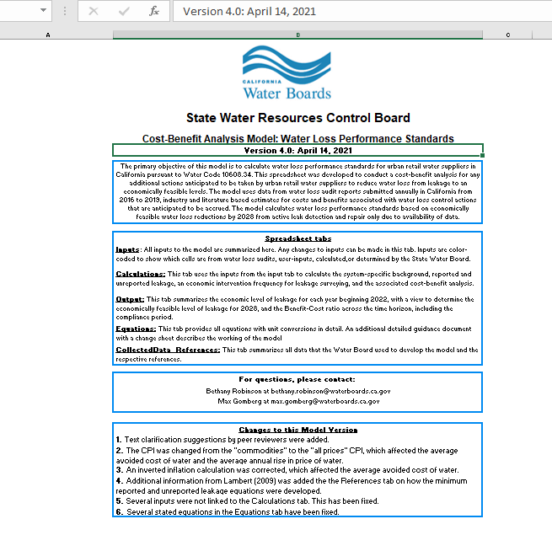
Water Loss Performance Standards
Proposed Changes to Regulation: Economic Model
Annual Rise in Price of Water from 4.6% to 1.3%
Buffer for the benefit to cost ratio from 1.0 to 1.5
2017 – 2022 baseline data with option to omit up to 2 outlier years
Model evaluation period from 30-year period to 15
30% cap on percent reduction for 2028 target

Slide 23
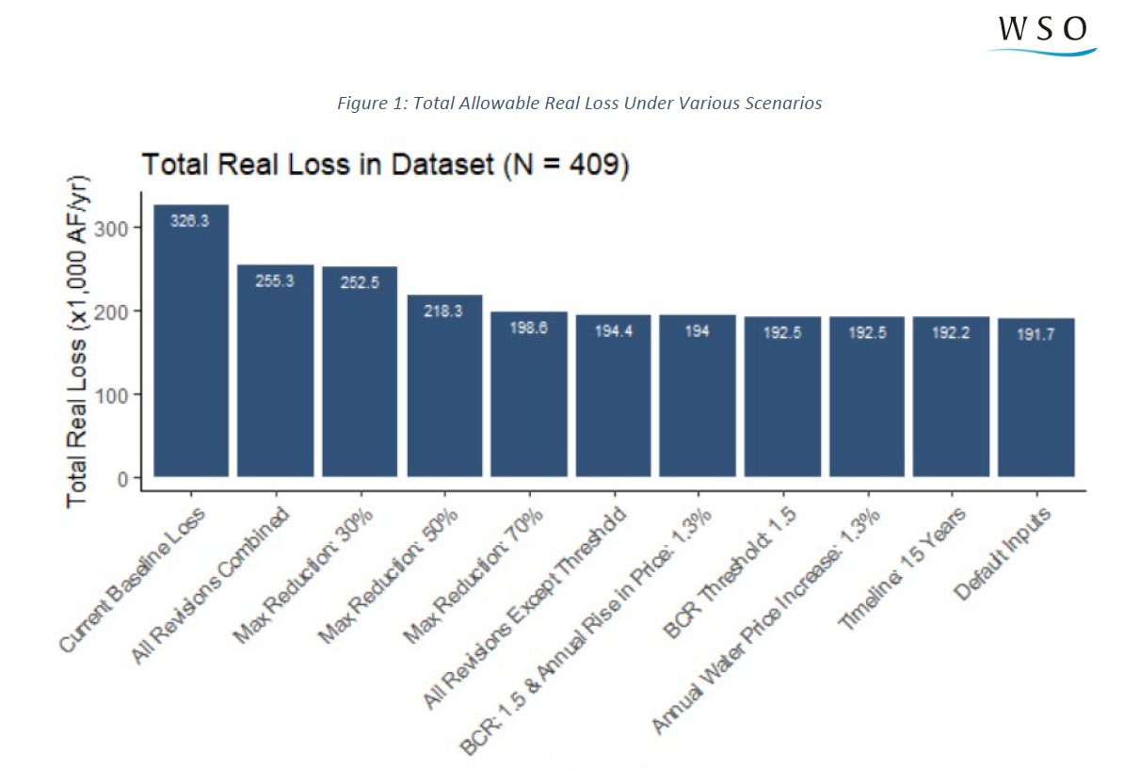
WSO Economic Model Changes Analysis
SWB wants to be here
We are here

Slide 24
Water Loss Performance Standards
Proposed Changes to Regulation: Policy
Compliance Plan: 30% from baseline, cost ratio threshold, improving data validity scores, try to customize the model
Disadvantaged Communities: more time to comply, automatically eligible for the Compliance Plan option
Current loss versus solve for 1 - current model loss targets when BCR less than 1 = not cost efficient inherently, should we all solve for 1 or great?
Off-Ramp: meet 5/9 rather than 9/9 criteria, not required to meet criteria outside control, use 2017 – 2022 audit data rather than 2017- 2020
Apparent Loss Target?

Slide 25
Water Loss Performance Standards
UC Davis Economic Water Loss Model
Optimization Model
Similar level of loss, less cost to suppliers
Focus on optimizing survey frequency
Hosted webinar
Uncertain how model will be used

Slide 26
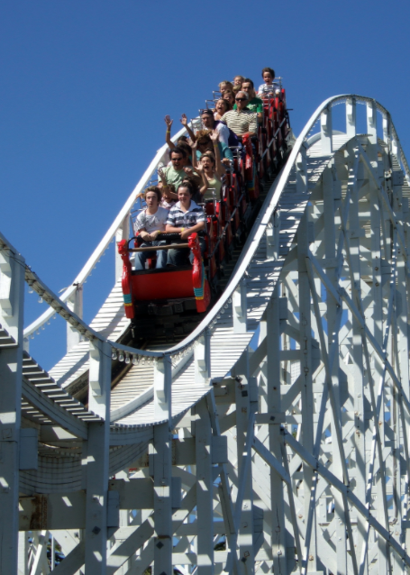
Water Loss Performance Standards
Summary
Formal Rulemaking – Winter 2021
Initial 45-day comment period
Encouraging suppliers to customize inputs, review past audit data (model baseline) and document water loss actions and cost
Not sure where the model will land
Working on policies that help outlier suppliers
Training/ technical assistance is needed

Slide 27
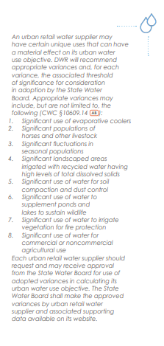
Variance and Bonus
Nicholas Schneider
Each Urban supplier should request and may be able to receive a variance when calculating its urban water use objective.

Slide 28
Questions and Comments?
Chelsea Haines, Regulatory Relations Manager
Chelseah@acwa.com

