Slide 1
Water Use Efficiency Work Group
March 20, 2023
3:00 PM – 4:00 PM

Slide 2
Meeting Agenda
WUE Regulatory Updates
SWRCB Proposed Recommendation
ACWA Concerns
Call for Your Engagement

Slide 3
WUE Regulatory Update
Oct. 2022 – DWR 21 technical reports
March 2023 – SWRCB preliminary regulatory framework
March 22 - Public Workshop (Speaker Card- # 7)
March 30 – Informal Written Comments
SRIA (to be posted here)
Formal Rulemaking
Formal comment period (reg text, SRIA, overall approach)

Slide 4
SWRCB Proposed Recommendation
Residential:
42 gpcd by 2030
(Wat. Code
§ 10609.4)
Residential: *0.55 LEF by 2035
Individual System Loss Standards or alternative compliance pathway
DWR 8 variances
+
2 SWRCB recommended
Potable recycled water
(Wat. Code
§ 10609.2)
CII landscape w/ DIMS:
0.45 LEF by 2035
+ CII Performance Measures

Slide 5
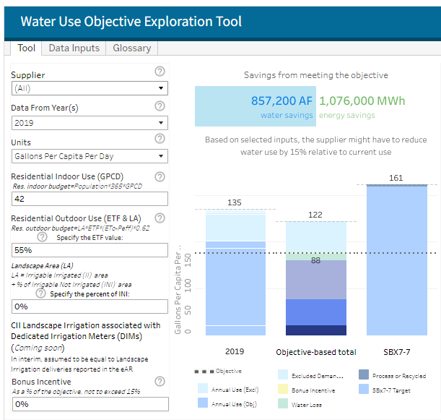
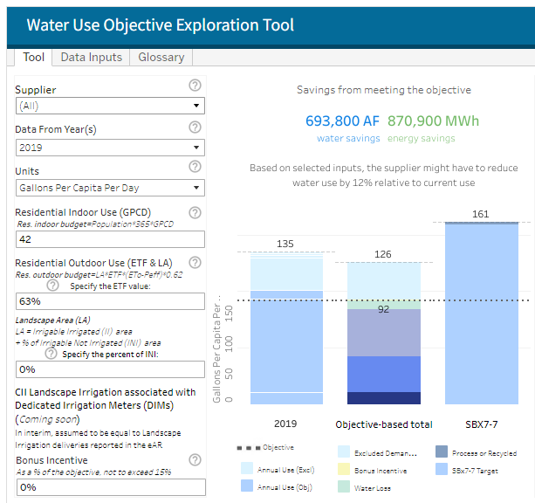
SWRCB Proposed Recommendation
State Water Board Water Use Objective Exploration Tool:
Residential Indoor: 42
Residential Outdoor: 0.63/ 0.55
Landscape area: 0
https://www.waterboards.ca.gov/water_issues/programs/conservation_portal/regs/objective-exploration.html

Slide 6
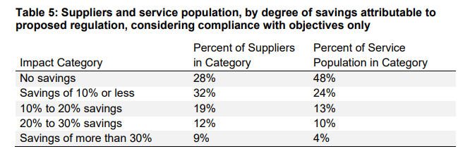
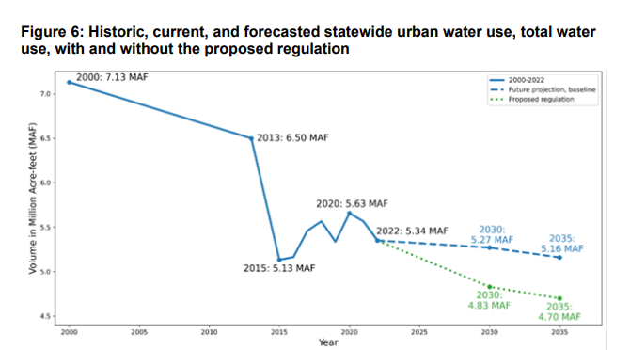
SWRCB Proposed Recommendation
SWRCB Perspective:
Water Supply Strategy– reduce demand by 500,000 AF by 2030
Water use efficiency observed as cost-effective
Proposed Objectives seem reasonable

Slide 7
SWRCB Proposed Recommendation
Proposed Outdoor Standards:
 | SWRCB Proposal | DWR Recommendation
Residential (Existing) | Now - 2030: 0.8 LEF 2030 – 2035: 0.63 LEF 2035 +: 0.55 LEF | Now - 2030: 0.8 ETF 2030 +: 0.63 ETF
New Construction (post-2030) | 0.55 LEF (Residential) 0.45 LEF (Non-Residential) | 0.55 ETF (Residential) 0.45 ETF (Non-Residential)
CII DIM | Now - 2030: 0.8 LEF 2030 – 2035: 0.63 LEF 2035 +: 0.45 ETF | Now - 2030: 0.8 ETF 2030 +: 0.63 ETF
Effective Precipitation | Up to 25% of calculated EP | Up to 25% of calculated EP

Slide 8
SWRCB Proposed Recommendation
Outdoor Standards:
 | SWRCB Proposal | DWR Recommendation
Irrigable, Not Irrigated | Up to 20%, if demonstrated those INI areas have come under irrigation. | 20% of INI (automatic INI Buffer)
Special Landscape Areas | -SLAs 100% LEF For residential areas and CII landscapes with DIMs, areas planted with non-functional turf would not be considered SLAs. This includes sites irrigated with recycled water. They would instead use whatever applicable standard is for the time period (80%, 63%, 55% or 45%) | SLAs 100% LEF

Slide 9
SWRCB Proposed Recommendation
Variances
SWRCB Proposed Recommendations
A provision for urban tree health
A provision for pools, spas & other water features (2030)
Process for including additional Irrigable Irrigated Area, Special Landscape Area & Variances
Annually request approval to include additional II area beyond that calculated by DWR, SLAs, and variances
URWS to provide information quantifying request and description of efforts to prioritize water for existing trees
DWR Recommended Variances:
Significant use of evaporative coolers
Significant populations of horses and other livestock
Significant fluctuations in seasonal populations

Slide 10
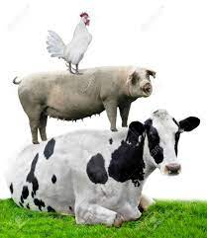
SWRCB Proposed Regulatory Framework
Significant LAs irrigated with recycled water having high levels of total dissolved solids
Significant use of water for soil compaction and dust control
Significant use of water to supplement ponds and lakes to sustain wildlife
Significant use of water to irrigate vegetation for fire protection
Significant use of water for commercial or noncommercial agricultural areas
Examples: Evaporative Coolers
URWS to calculate based on information collected from customers
Conditions & Proof (e.g., customer picture of EC and unit specification, minimum air temp)
DWR recommends that URWS establish a report for or survey to obtain information, must obtain EC Operating Hours in each residential property in its service area, hourly weather data

Slide 11
SWRCB Proposed Regulatory Framework
CII Performance Measures
Install DIMs or in-lieu technologies for landscapes of CII customers
Do not have a DIM
Estimates using 500 million gallon of water or more annually
Classify customers according to Energy Star Portfolio Manager tool
Suppliers to offer BMPs to their customers
For customers that own on manage a building a “disclosable building” under CEC “Benchmarking” regulation, supplies required to provide annual water use data in format compatible with ENERGYSTARS Portfolio Manager tool.
Energy Star Classifications
Banking/ Financial services Education Entertainment/ public assembly Food sales and service Healthcare Lodging/ residential Manufacturing/ industrial Mixed use Office Parking Public service Religious Worship Retail Technology/ science Services Utility Warehouse/ storage Other

Slide 12
SWRCB Proposed Regulatory Framework
CII Performance Measures
Suppliers to offer BMPs to their customers (cont.)
Customers in top 20% of water use relative to customers within specific CII classification, design and implement a conservation program that includes at least 1 BMP from 5 categories
Customer in top 2.5% of water use of all CII customers. The supplier should design and implement at least 2 BMPs from each BMP category
Energy Star Classifications
Banking/ Financial services Education Entertainment/ public assembly Food sales and service Healthcare Lodging/ residential Manufacturing/ industrial Mixed use Office Parking Public service Religious Worship Retail Technology/ science Services Utility Warehouse/ storage Other

Slide 13
ACWA Concerns
Outdoor Standard
Methodology
Horticultural Approach – 0.8 IE
Statewide ETF – Trimmed Data
Theoretical Average – Application of MWELO
INI (inconsistent with water code)
Effective Precipitation
Special Landscape Areas & non-functional turf
Feasibility
Cost
Timeline
Compliance
Caps/ Alternative Compliance
Effective Precipitation
Policy Considerations
ORWUS
Methodology

Slide 14
ACWA Concerns
CII Performance Measures
Implementation timelines and compliance should provide flexibility, rather than being prescriptive.
PM should support suppliers’ efforts or strategies to advance WUE in the CII sector.
URWS compliance should be determined by local and regional availability of PMs, rather than customer level adoption.
Simplify reporting burdens on URWS.
The State should provide technical assistance and data as soon as possible.
Recognize CII LAM mapping will improve data for the CII DIM standard.
Variances
Data burden on water suppliers
State Water Board capacity and resources required
Provide technical Assistance Provided

Slide 15
Call for Your Engagement
March 22 - Board Workshop Speaker Card
Help highlight feasibility, cost and timeline concerns
Conservation budgets over time
Savings per use
Amount of customers reached
Amount of landscaped area reached
Cost to implement level required
Local challenges
March 30 – Informal Written Comments
orpp-waterconservation@waterboards.ca.gov
Please forward your comments to Chelseah@acwa.com

