Slide 1
Water Use Efficiency Work Group
Bi-Monthly Meeting
June 16, 2021
10:00 AM – 12:00 PM

Slide 2
Meeting Agenda
April 21, 2021  10:00 AM – 12:00 PM
Chair Welcome – Elizabeth Lovsted
Drought Update/ Communications – Chelsea Haines
Urban Water Use Efficiency Updates – Elizabeth Lovsted
Indoor Standard - Amy McNulty
Commercial, Industrial and Institutional Standards - Ariel Flores
Water Loss Performance Standards - Amy Talbot
Variance and Bonus – Nicholas Schneider
Outdoor Water Budget Development & Implementation - Fiona Sanchez
AWWA Updates – Sue Mosberg

Slide 3
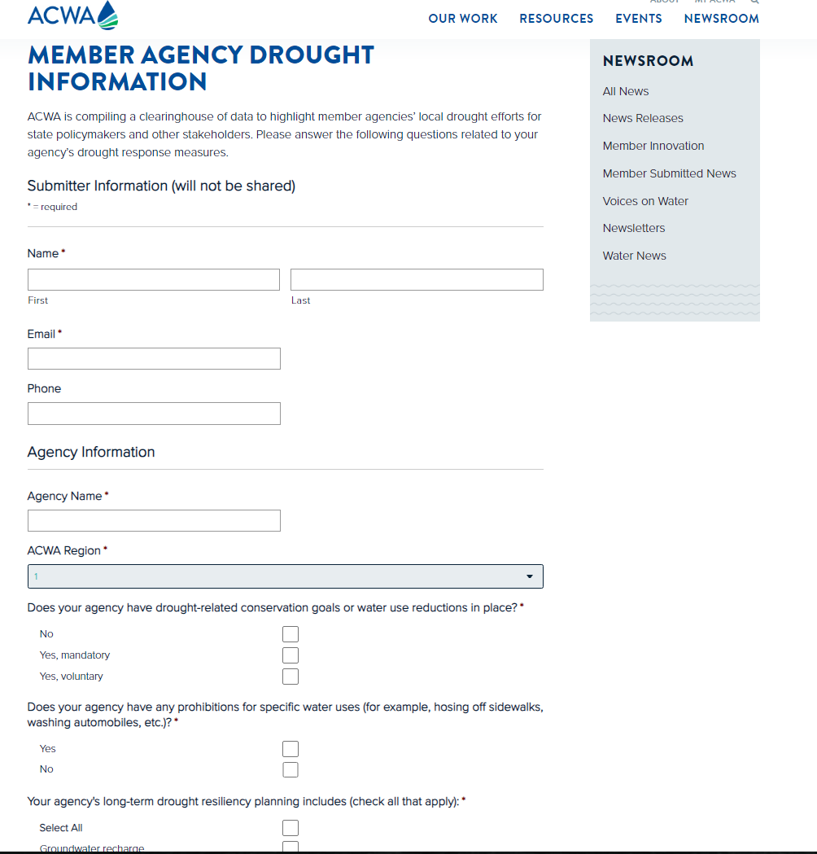
Drought Update/ Communications
https://www.acwa.com/member-agency-drought-information/
2 Minute Survey to ACWA Members
Conservation Goals
Prohibitions of water uses
Water Shortage
Links
Other Actions

Slide 4
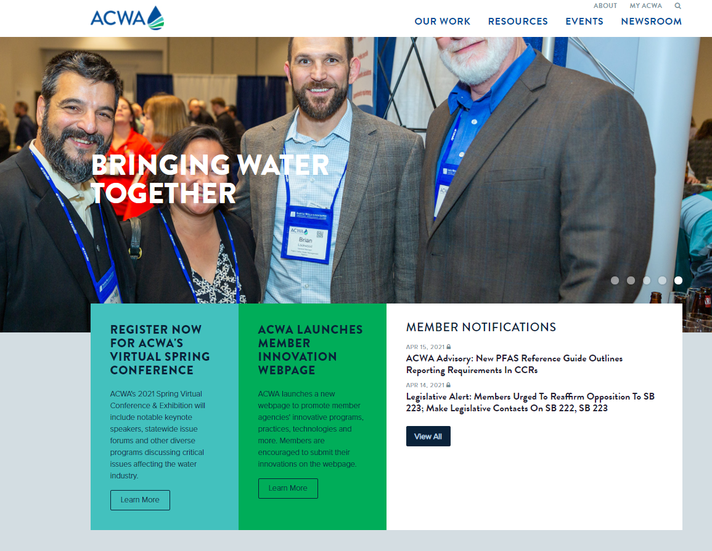
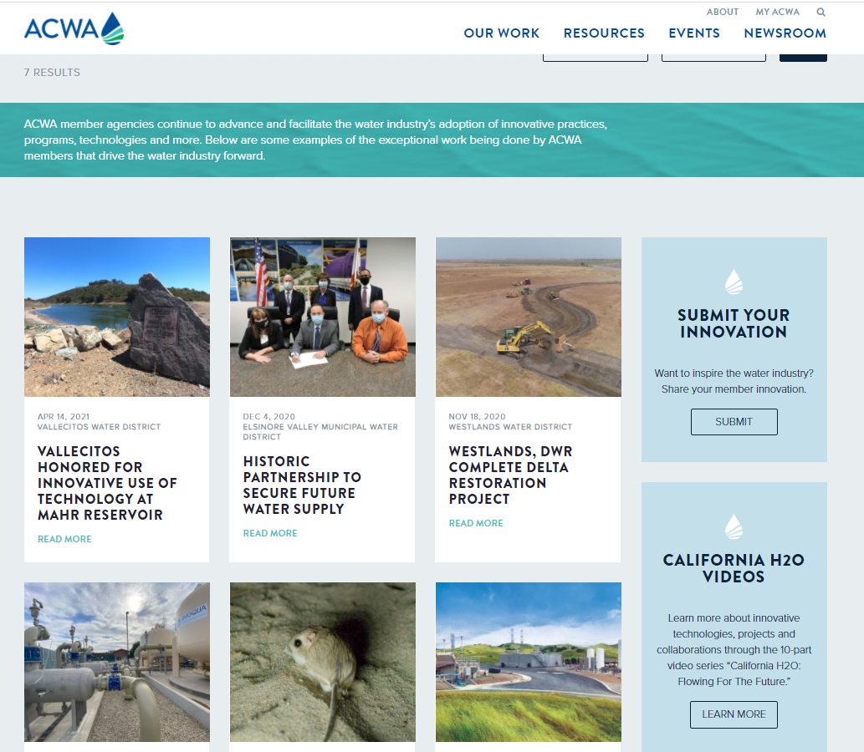
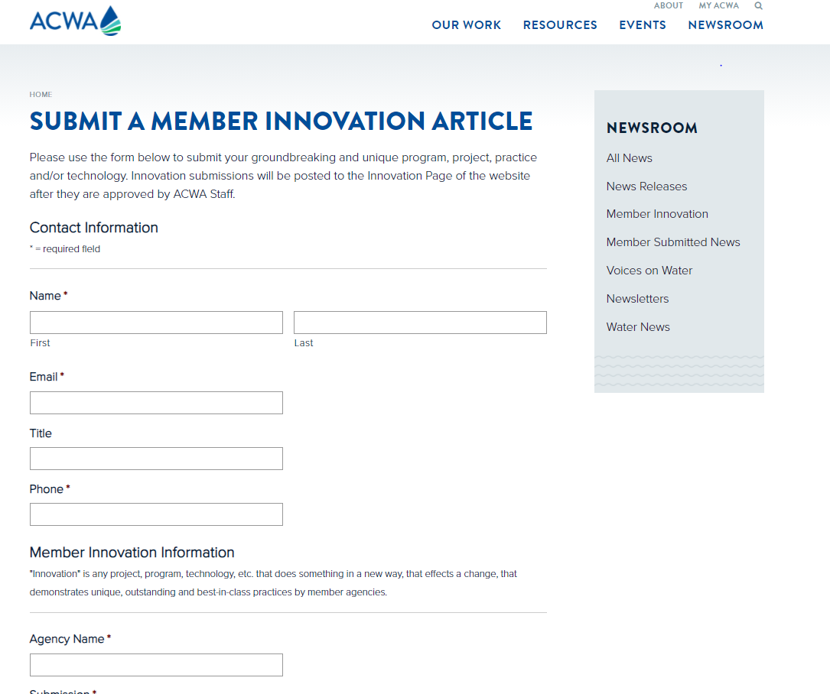
Drought Update/ Communications
Submit to ACWA!
https://www.acwa.com/submit-a-member-innovation-article/

Slide 5
Urban Water Use Efficiency Updates
Elizabeth Lovsted
Component | Timing | Lead Agency
Permanent monthly reporting | Since Oct. 1, 2020 | SWRCB
Water loss standards | End of 2020 2021 | SWRCB
Recommendation on indoor standards | January 2021 June 2021 | DWR
Residential irrigable land measurements | January 2021 March 2021 | DWR
Recommendation on WUE standards* | October 2021 | DWR
UWMP/WSCP updates | July 2021 | DWR
Adoption of WUE standards* | July 2022 | SWRCB
Annual water shortage assessment | June 2022 | DWR
*WUE standards include:
Outdoor residential use standard
Standard for CII outdoor landscape area with dedicated irrigation meters
Performance measures for CII water use
Appropriate variances
Guidelines and methodologies for calculating urban water use objectives

Slide 6
Urban Water Use Efficiency Updates
Indoor Standard
June – DWR to release Final Report
Outdoor Standard
June 30 – Deadline to report on data related issues that can affect the outdoor standard setting process
August 30 – Deadline for DWR review submitted adjustment requests and deliver final LAM data to the suppliers
CII Performance Measures
June 28 @ 1:00 pm – DWR Monthly CII Meetings
Variance & Bonus
July 8 @ 1:00 pm – DWR Monthly Meeting
Water Loss Performance Standards
Late Summer? – Formal Rulemaking w/ 45 public comment period
Fall? – Deadline to submit updates to the model defaults (end of the 45-day comment period)

Slide 7
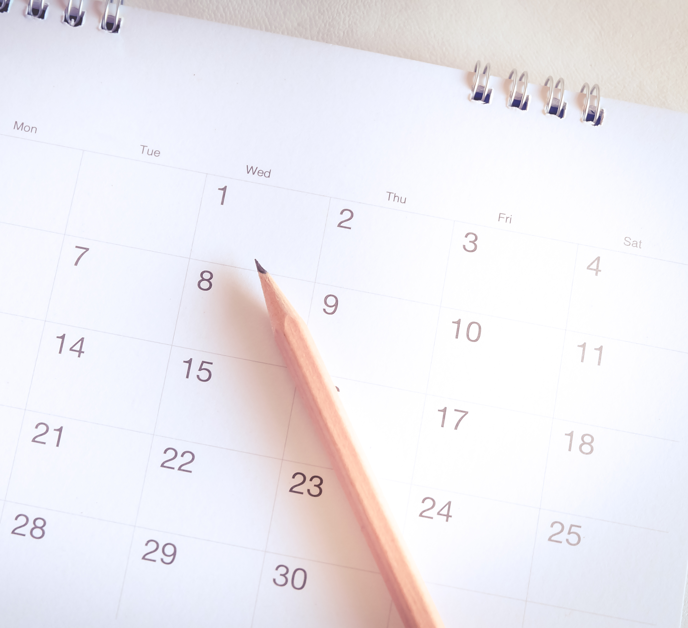
Urban Water Use Efficiency Updates
ACWA Working Groups:
Bi-Monthly WUE – Third Wednesday every other month from 10:00 am – noon
Indoor – Mondays from 2:00 – 3:00 PM
Outdoor – Tuesdays from 2:00 – 3:00 PM
CII – Every other Wednesday from 3:00 – 4:00 PM
Variance & Bonus – TBD
Water loss – As needed
* To be added to a subcommittee, please contact chelseah@acwa.com

Slide 8
Water Use Efficiency Updates
Promoting Effieincy
Proactive approach
Develop white papers with recommendations
Technical staff meetings
Present proposals and recommendations
Bi-weekly meetings with DWR management

Slide 9
Urban Water Use Efficiency
ACWA Work Group Advocacy
Indoor Standard
Additional study required before state agencies should make a recommendation
Outdoor Standard
Evapotranspiration adjustment that reflects efficiency
CII Performance Measures
Classification categories
Focus on new development for dedicated meter (no threshold)
Water Supply and Demand Assessment
Provided sample reports

Slide 10
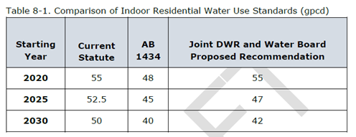
Indoor Residential Water Use Standard
Amy McNulty, Nicholas Schneider
April 22 - DWR shared preliminary recommendations
May 4 – ACWA met with DWR Executive Director Nemeth to discuss concerns that DWR has not collaborated with stakeholders and analyzed impacts to water and wastewater management
May 10 – DWR released the “Public Review Draft Report to the Legislature on Results of the Indoor Residential Water Use Study”
May 21 – DWR held additional working group and public workshop w/ ACWA input on agenda

Slide 11
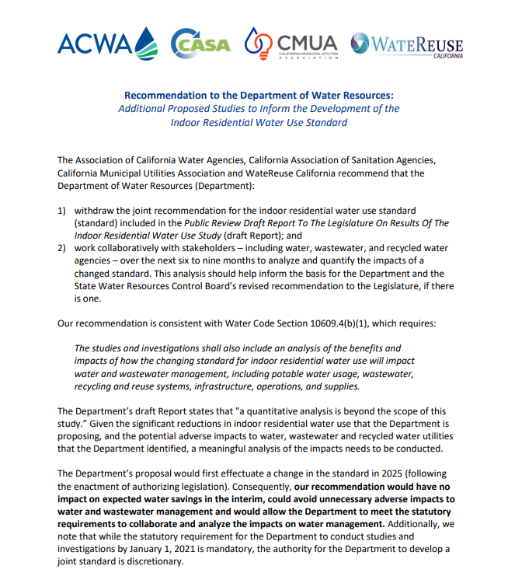
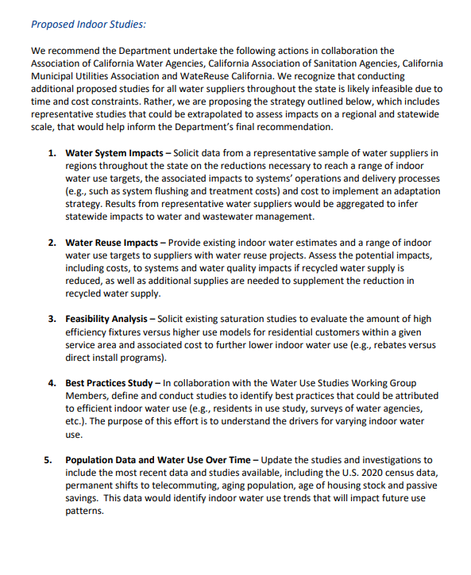
Indoor Residential Water Use Standard
Amy McNulty, Nicholas Schneider
Recommendations:
Withdraw Joint Recommendation for IRWUS
Collaborate with stakeholders over 6 – 9 months to analyze and quantify impacts of a changed standard
Conduct The Following Studies:
Water System Impacts
Water Reuse Impacts
Feasibility Analysis
Best Practices Study
Population and Water Use over Time

Slide 12
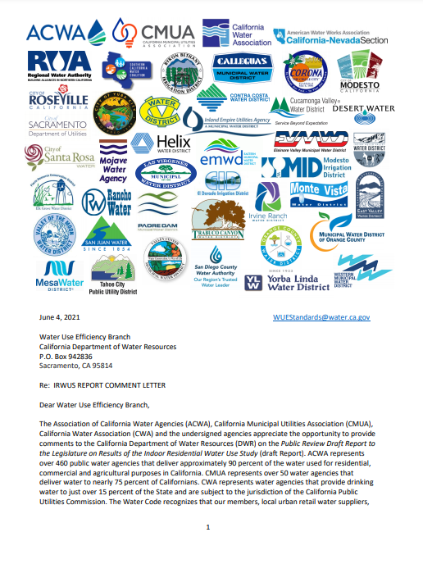
Indoor Residential Water Use Standard
Amy McNulty, Nicholas Schneider
May 24 – ACWA alert for Members to join coalition letter
June 4 – ACWA submitted coalition comment letter. Concerns include:
Collaboration with water, wastewater and recycled water agencies
Analysis of impacts of a changed standard
Operational impacts
Cost impacts
Feasibility
Affordability
Other: Population, Telecommuting
Consideration within Making Water Conservation a California Way of Life

Slide 13
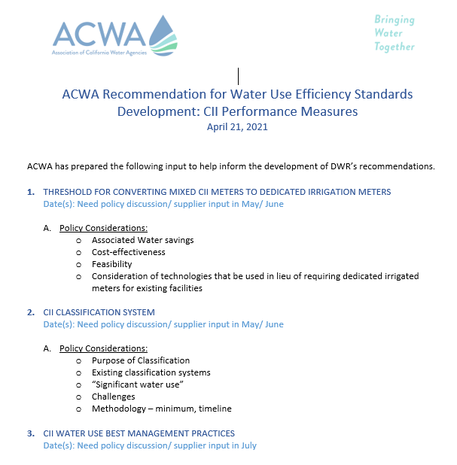
CII Performance Measures
Ariel Flores
ACWA Standard Development Recommendations to DWR (presented 4/21)
Threshold for Converting Mixed CII Meters to Dedicated Irrigation Meters
CII Classification System
CII Water Use Best Management Practices
Draft Performance Measures

Slide 14
CII Performance Measures
ACWA Recommendation for CII Performance Measures Conversion of Mixed CII Meters
Performance measures should achieve water savings and be cost-effective
Concerns & challenges of converting CII mixed-use meters to split
Failure to Guarantee Water Savings
Cost-Effectiveness of Water Savings
Complex Implementation
ACWA’s Recommended Approach
Recognize Conversation to Split Meter as a Best Practice & Prioritize Dedicated Irrigation Meters for New CII Development
Recommend Prioritizing In-lieu Technologies for Existing CII Facilities

Slide 15
CII Performance Measures
No. | Main | Category | Description
1 | Commercial | 1a. Office | Any office building with or without Cooling Towers
 |  | 1b. Retail Stores/ Services | Any retail stores/ services of wet and dry food market
 |  | 1c. Warehouse and Storage (Non-Temperature Controlled) | Any warehouse or storage building with non-perishable items (clothing, toys, etc)
 |  | 1d. Food Sales and Service | Any food service or restaurants (full service or non-full service)
 |  | 1e. Hotels and Lodgings | Any Hotels, Motels, extended stay, etc
 |  | 1f. Athletic Clubs and Gyms | Any Athletic Clubs (YMCA…etc) and Gyms (Planet Fitness, 24 Hr Fitness)
 |  | 1g. Theme Parks and Recreational Water Facilities | Any Theme Parks (Disneyland, Knotts Berry farm Water Facilities (Raging Waters…)
 |  | 1h. Entertainment/ Public Assembly | Any Concert Halls, Movie Theater, etc
 |  | 1i. Vehicle Wash (Automatic, Auto Detailer) | Any auto Car wash or Car wash with detailing
 |  | 1y. Mixed Commercial (For meters with multiple connections) | Any Commercial facility with multiple connections on one (1) meter account
 |  | 1z. Miscellaneous - Commercial | Any Commercial facility that does not fit the description of the above categories
2 | Industrial | 2a. Industrial (Manufacturing and Product Research facilities) | Any Industrial Manufacturing and Product research (Food, Beverage, Pharmaceutical other industrial products)
 |  | 2b. Warehouse and Storage (Temperature Controlled) | Any Storage Warehouse that uses Cooling systems for Temperature controlled or perishable products
 |  | 2c. Industrial Laundry and other laundry facilities | Any fabric cleaning (Uniform and Linen Supply, Washers and Dry Cleaners and Coin washers)
 |  | 2y. Mixed Industrial (For meters with multiple connections) | Any Industrial facility with multiple connections on one (1) meter account
 |  | 2z. Miscellaneous - Industrial | Any Industrial facility that does not fit the description of the above categories
3 | Institutional | 3a. Education (Universities, Colleges, HS, Elem, Pre-school) | Any Universities, Colleges, Educational facilities (HS, Elementary, Pre-school)
 |  | 3b. Healthcare (Hospitals, Clinics, Lab facilities) | Any Hospitals, Medical Clinics, Dental Offices, Medical and Laboratory Services
 |  | 3c. Government & Utilities (Federal, State, County, City) | Any Govt Agency Offices, Prisons, Correctional. Any Water District, Gas Power Supply, Electricity Power Supply Companies, & Solid Waste
 |  | 3y. Mixed Institutional (For meters with multiple connections) | Any Institutional facility with multiple connections on one (1) meter account
 |  | 3z. Miscellaneous - Institutional | Any Institutional facility that does not fit the description of the above categories

Slide 16
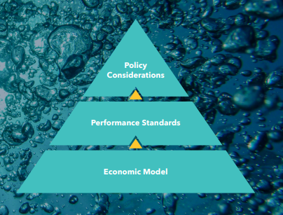
Water Loss Performance Standards
Amy Talbot
Proposed Changes to Regulation: Economic Model
Annual Rise in Price of Water from 4.6% to 1.3%
Buffer for the benefit to cost ratio from 1.0 to 1.5
2017 – 2022 baseline data with option to omit up to 2 outlier years
Model evaluation period from 30-year period to 15
30% cap on percent reduction for 2028 target

Slide 17
Water Loss Performance Standards
Proposed Changes to Regulation: Policy
Compliance Plan: 30% from baseline, cost ratio > 2, improving data validity scores, customized inputs to model prior to July 1, 2023
DACs: compliance assessed in 2035 rather than 2031, cost-benefit ratio increased to 3, automatically eligible for the Compliance Plan Option
Off-Ramp: meet 5/9 rather than 9/9 criteria, not required to meet criteria outside control, use 2017 – 2022 audit data rather than 2017- 2020
BCR of less than 1: target set model’s output when BCR is solved for 1 and include standard 5 gpcd buffer
Customized Input Data: clarify submission process

Slide 18
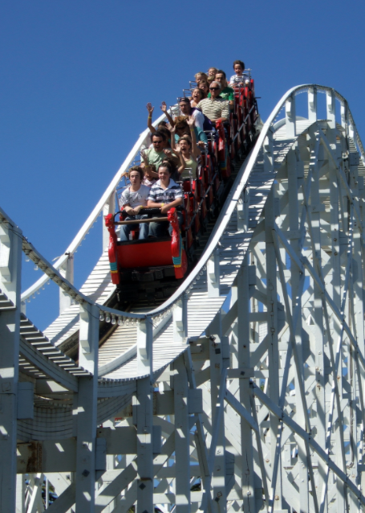
Water Loss Performance Standards
Next Steps
Formal Rulemaking: June 2021 w/ 45-day comment period [Delayed-TBD]
Model Revisions: April 15 revised Economic Model
Suppliers can submit updates to the model defaults by emailing a copy of the economic model with changed defaults and attached justification to orpp-waterconservation@Waterboards.ca.gov .
The deadline to submit updates to the model defaults will be the end of the 45-day comment period (TBD).
Documentation – Start/continue documenting water loss work and costs

Slide 19
Outdoor Water Use Standard
Fiona Sanchez
ACWA Standard Development Recommendations to DWR (presented 4/20)
Residential Area Measurements
Methodology for Corrections: new development, land use, incorrect measurements, service area boundaries, vacant parcels, disputed areas, missing parcels, dedicated irrigation meters
Adjustment Factor(s) Irrigated/ Irrigable Area
Precip Calculations
CIMIS

Slide 20
Outdoor Water Use Standard
Residential LAM Data
Water Supplier Review of DWR Residential LAM Data due to DWR, June 30
https://forms.monday.com/forms/201637400ae432d056020ea36b62f610?r=use1
Variance Process
State Water Resources Control Board review and approval
Timing and process still to be determined
How will the application of variances be incorporated into DWR analysis of proposed outdoor factors?
Use of Alternative Data
Section 10609.20 (2): An urban retail water supplier may use alternative data in calculating the urban water use objective if the supplier demonstrates to the department that the alternative data are equivalent, or superior, in quality or accuracy to the data provided by the department.
Process and timing to be determined by DWR
How will alternative data use be incorporated into DWR analysis of proposed outdoor standard?

Slide 21
Outdoor Water Use Standard
DWR to develop recommendations by October 1, 2021:
Implications of MWELO Statewide
Complexity vs ease of calculation
Assumptions regarding supplier data (eAR etc.)
Special Landscape Areas
Parks
Functional turf
Recycled water
Residential Landscape and Dedicated Meters (potable and recycled)
Use of precipitation data
EOWU = (ETo – Peff) * (0.62) * OWUS * LAs
Where EOWU = Efficient Outdoor Water Use (gal)
ETo = Reference evapotranspiration (inches)
Peff = Effective precipitation (inches)
OWUS = Outdoor Water Use Standard (unitless)
LAs = Landscape area for supplier (sq. ft)
0.62 = unit conversion factor

Slide 22
Outdoor Water Use Standard
Considerations in Setting Outdoor Standard
Standard needs to be reasonable
Standard should be based on efficiently maintaining existing landscapes
Majority of properties in California not subject to MWELO – constructed before 1993
2015 MWELO applies ETAF of 0.8 to existing landscapes and does not require an adjustment for precipitation

Slide 23
Outdoor Water Use Standard
ACWA Recommendations to DWR (presented June 11)
0.8 ETAF for outdoor landscape standard
Applies to majority of landscapes statewide
MWELO is a design not a performance standard
Even for new landscapes, MWELO typically does not apply to residential backyards which are installed by homeowners
1.0 ETAF for Special Landscape Areas (parks, etc.) and areas irrigated with recycled water 1.0 ETAF consistent with MWELO
The 1.0 ETAF does not include any additional variance needed for recycled water for leaching high salts
Should not incorporate adjustment for precipitation
Not required by MWELO
Complex; not enough data/studies /pilots

Slide 24
Outdoor Water Use Standard
Standards and Methodologies
Next Meeting Next Wednesday, June 30
Stakeholder forum to discuss and inform policy questions. Outdoor issues include, but not limited to:
Outdoor Standard recommendations
Use of Irrigable and Irrigated
Addressing changes in outdoor landscape area over time
Determining acceptable levels of accuracy for supporting data and compliance with Water Use Objective

Slide 25
Outdoor Water Use Standard
Outdoor Water Budget - Summary
Residential LAM Corrections Due to DWR
June 30, 2021
Standards and Methodologies Workgroup Meeting
June 30, 2021
DWR to finalize Residential LAM Data
August 30, 2021
Outdoor Factors and Recommended Standards
DWR to develop recommendations by October 1, 2021
Supplier Calculated Water Use Objective
Due January 1, 2024
ACWA continues to collaborate with DWR staff regarding outstanding issues

Slide 26
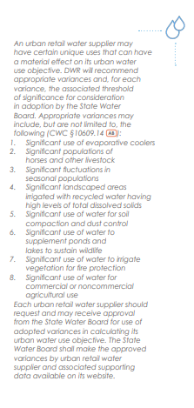
Variance and Bonus
Nicholas Schneider
Each Urban supplier should request and may be able to receive a variance when calculating its urban water use objective.

Slide 27
CA-NV AWWA Update
Sue Mosburg
Water Loss Training
View a complete schedule of upcoming course & workshops at: www.ca-nv-awwa.org/schedule
Water Audit Validator (WAV)
All WAV certificates due to expire in 2021 have been automatically extended through 2022.
WRF project 5057 – Level 1 Water Audit Validation Guidance Manual v2 (for Audit software V6) Fall 2021
WAV V6 training September 2021
Water Use Efficiency Practitioner
Water Use Efficiency 8/3-5/2021 (12 hours)
Virtual Event
Partnership for Safe Water 25th Anniversary Optimization Conference July 27-29, 2021
Virtual Event Water Education Seminar August 18, 2021
Virtual Event – accepting abstracts Annual Fall Conference October 18-21, 2021

Slide 28
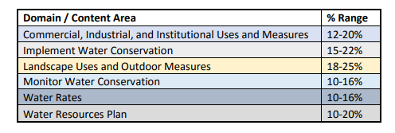
CA-NV AWWA Update
Water Use Efficiency Practitioner Certification
Level 1
Levels 1-3
Included concepts, terms and definitions associated with specific ranges of subjects
Computer based or traditional pencil/scantron
Level 2
Notes:
Level 3 Range of Knowledge is being reworked into the new format
Level 1 focus is heavy on landscape and residential
Level 2 focus is landscape implementing water conservation and added area of water resources planning
Level 3 focus is program design, monitoring, management, analysis, evaluation – integrated planning
New recommended study materials lists for all grade levels.
New Need to know criteria for level 1&2
Currently certified
Level 1 – 274
Level 2 – 50
Level 3 – 26

Slide 29
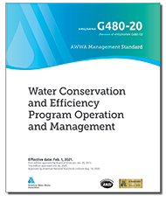
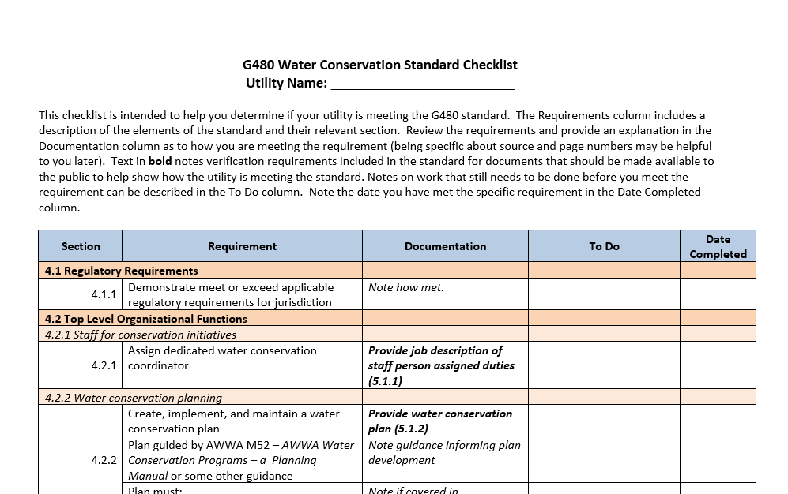
CA-NV AWWA Update
Water Conservation & Efficiency Program Operation & Management Standard
New AWWA G480 Standard (February 1, 2021)
Includes the following voluntary requirements:
Dedicated staff for conservation initiatives (point of contact)
Conservation and efficiency planning
Integrated resources planning
Water shortage or drought planning
Public information and education program
Water waste ordinance
Universal metering practices
Source water metering
Nonpromotional water rate structure
Monthly or bimonthly billing based on metered use
Landscape efficiency program
Validated water audit and water loss control program
Coordinated building code and land use planning
Notes:
Things change – learn what has been, what is being done, to create new and move forward on your conservation coord journey.
Start by assessing what you have:
This standard describes the critical elements of an effective water conservation and efficiency program. It encompasses activities undertaken by a utility within its own operations to improve water use on the supply side upstream of customer meters through distribution system management, and on the demand side downstream of customer meters through customer billing and education practices. A program meeting this standard has the potential to impact all water users.
Last updated in 2020, and effective February 1, 2021
These components can serve as an outline for areas of responsibility to be covered as team by your agency.
AWE is verifying utility compliance with the G480 Standard, and maintains a leaderboard. AWE will review and verify submissions from current members free of charge.

Slide 30
Questions and Comments?
Chelsea Haines, Regulatory Relations Manager
Chelseah@acwa.com

