Slide 1
ACWA WUE Working Group
Data (WUE Exploration Tool, Provisional Data, Data Needs)
9.20.23
Chair: Nate Adams
Contact Sonjae@acwa.com to be included on the working group

Slide 2
Agenda
ACWA WUE Working Group - Data
Welcome & Meeting Goals Nate Adams
Receive feedback on data issues and discuss data gaps and needs for WUE reg implementation
Exploring State-Provided Data Nate Adams & Amy Talbot
High-Level Issues for Comment Letter? Working Group
Discrepancies between tool and dataset
Reporting years (CY vs FY) & duplicative reporting
Data needs / requested technical assistance
Data frequency for variance (annual vs. every X years?)
Data error, need for buffer in compliance
Next Steps? Chelsea Haines

Slide 3
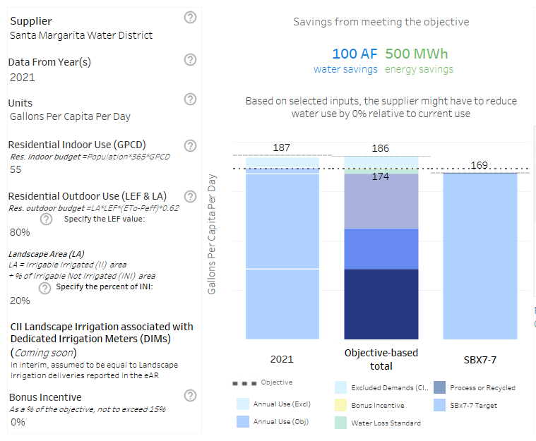
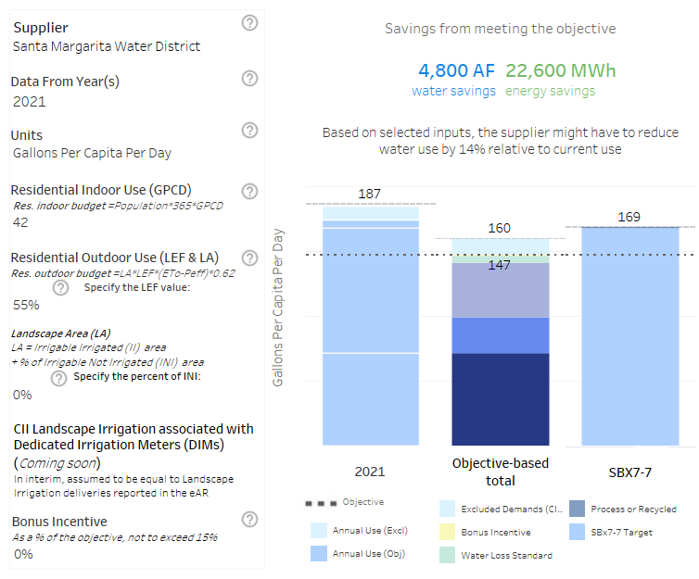
SWRCB Exploration Tool & Dataset - Review & Discussion
Example: Santa Margarita Water District (using 2021 water use)
SWRCB Water Use Objective Exploration Tool Webpage
2024
2035
Notes:
2024 = 147
2035 = 174
15% reduction

Slide 4
SWRCB Exploration Tool & Dataset - Review & Discussion
Example: Santa Margarita Water District ET Data (using 2021)
 | 2021 Evapo-transpiration* | 2021 Effective Precip.** | Calc’d 2030 Residential Outdoor Budget (AF) *** | Calc’d 2035 Residential Outdoor Budget (AF)***
SWRCB Dataset | 48.43” | 4.83” | 5,850 | 5,106
SMWD & CIMIS Station 245 | 54.24” | 2.85” | 6,930 | 6,047
Difference | 12% | 41% | 18%
* State’s evapotranspiration and precipitation data from Spatial CIMIS; Cal-SIMETAW model to be used in future.
** Curiously, state’s dataset omits actual precipitation so we cannot directly calculate effective precipitation; cannot validate or back-calculate the value given. Effective precipitation = 25% of precipitation.
*** Using the LAM data for residential parcels, provided by DWR.

Slide 5
SWRCB Exploration Tool & Dataset - Review & Discussion
Residential Outdoor Budget Tool to Evaluate DWR LAM & Weather Variables
Insert your retail agency values
But how sensitive is your Agency to INI & Effective Precipitation?

Slide 6
SWRCB Exploration Tool & Dataset - Review & Discussion
Residential Outdoor Budget Tool to Evaluate DWR LAM & Weather Variables
Arbitrarily Reducing
INI Area
&
Evaporation (via Effective Precipitation)
=
Outdoor Budget
But how sensitive is your Agency to INI & Effective Precipitation?

Slide 7
SWRCB Exploration Tool & Dataset - Review & Discussion
Residential Outdoor Budget Tool to Evaluate DWR LAM & Weather Variables
Insert your retail agency values

Slide 8
SWRCB Exploration Tool & Dataset - Review & Discussion
Sacramento Regional Water Authority
Notes:
2024 = 147
2035 = 174
15% reduction

Slide 9
High-Level Issues for Comment Letter?
WORKING GROUP
Discrepancies between tool and dataset
Reporting years (CY vs FY) & duplicative reporting
Data needs / requested technical assistance
Data frequency for variances (annual vs. every X years?)
Data error, need for buffer in compliance
Ease reporting burden?
Notes:
2024 = 147
2035 = 174
15% reduction

Slide 10
High-Level Issues for Comment Letter?
WORKING GROUP
Discrepancies between tool and dataset
Reporting years (CY vs FY) & duplicative reporting
How to reconcile different dates?
Examples:
Water Loss reporting FY or CY, agency discretion
Different standards at different dates
Outdoor standards on July 1st
Indoor standards Jan 1st
Reporting to which agency?
DWR has stated it can give SWRCB credential to view raw submitted data
Data needs / requested technical assistance
Ex: Variance technical assistance, such as helping retailers with the assessment & application for variances
Data frequency for variances (annual vs. every X years?)
Data error, need for buffer in compliance
Ease reporting burden?
Examples are numerous
CII top 20%, period vs. top 20% in each of 21 CII categories
Notes:
2024 = 147
2035 = 174
15% reduction

