Slide 1
Water Use Efficiency Work Group
Bi-Monthly Meeting
January 11, 2023
10:00 AM – 12:00 PM

Slide 2
Meeting Agenda
January 10, 2023  10:00 AM – 12:00 PM
Chair Welcome – Elizabeth Lovsted
Drought Update – Chelsea Haines
Drought & Conservation Technical Reporting Order – Chelsea Haines
Legislative Update – Julia Hall
Water Use Objective Updates – Elizabeth Lovsted
CII Performance Measures – Ariel Flores
Outdoor Residential Water Use Standard – Fiona Sanchez
Variances – Elizabeth Lovsted
Bonuses – Fiona Sanchez
Next Steps

Slide 3
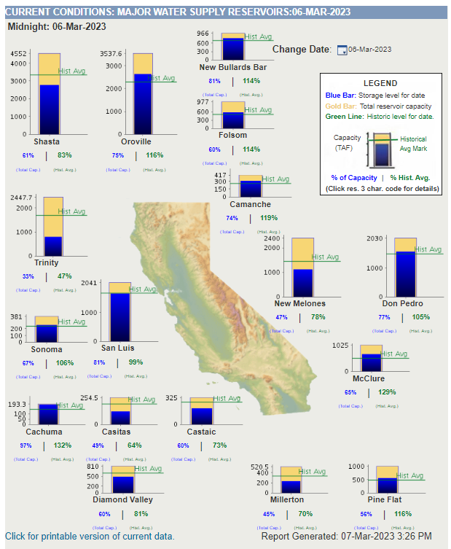
Drought Update
Chelsea Haines
Executive Order - Feb. 1 2023
EOs remain in full effect
Expedited permitting of GW recharge
Modified reservoir operations
State agencies to send recommendations by April 28 on necessary drought responses

Slide 4
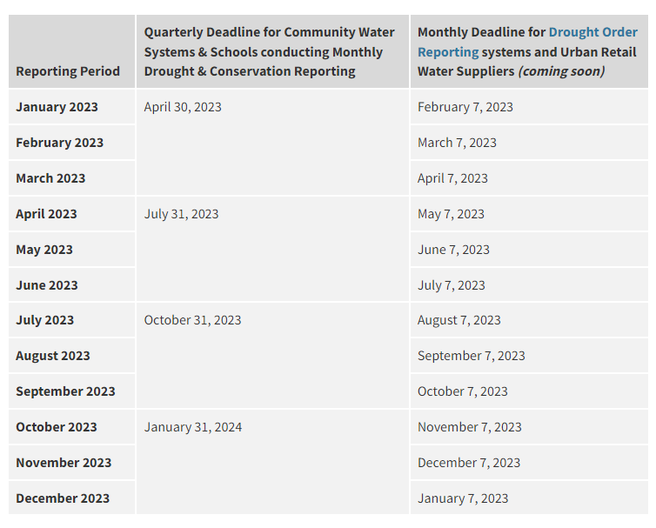
Drought & Conservation Reporting Order
Chelsea Haines
ACWA Concerns
Public Process
Purpose/ Benefit
Duplicative Reporting
Burden on Water Suppliers
Technical Concerns
Each Groundwater Well
Each Surface Water
Water loss

Slide 5
Legislative Update
Julia Hall
AB 1572 (Freidman)
AB 1072 (Wicks)

Slide 6
Water Use Objective Update
Elizabeth Lovsted
42 gpcd by 2030
*0.63 ETF by 2030
Individual System Loss Standards or alternative compliance pathway
*Sufficient evidence supports the establishment of 8 variances identified in the legislation”
Defined in legislation
* DWR recommendation; not final

Slide 7
Water Use Objective Update
Elizabeth Lovsted
Next Steps:
Standardized Regulatory Impact Assessment (SRIA)
Any Day (visit link)
March 22 – State Water Board Workshop
ACWA has requested a water supplier panel
Board may provide guidance to staff
Formal Rulemaking
End of the Year Adoption?

Slide 8
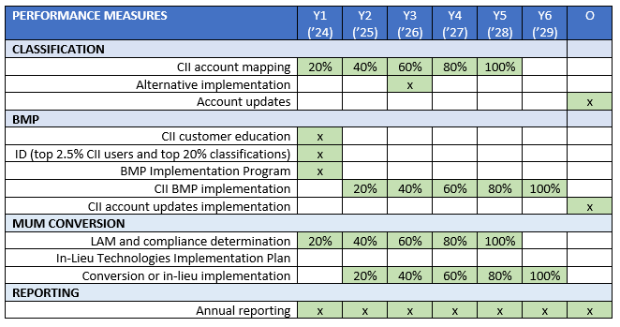
CII Performance Measures
Ariel Flores
ACWA Overarching Concerns
Implementation timelines and compliance should provide flexibility, rather than being prescriptive.
PM should support suppliers’ efforts or strategies to advance WUE in the CII sector.
URWS compliance should be determined by local and regional availability of PMs, rather than customer level adoption.
Simplify reporting burdens on URWS.
The State should provide technical assistance and data as soon as possible.
Recognize CII LAM mapping will improve data for the CII DIM standard.

Slide 9
CII Performance Measures
Ariel Flores
Summary of DWR Recommendations
Classification: URWS to map CII water use accounts into 19 classifications (by Year 5, with 20% mapping annually).
BMP: URWS to develop a CII Supplier BMP Implementation Program (by Year 3) that identifies one CII Water Supplier BMP for each of the 5 categories of actions. URWS to identify targeted CII water users and sectors that exceed a threshold of significance and associated BMPs.
MUM Conversion Threshold: For landscapes areas of 1 acre of greater on a per-parcel basis that are irrigated by a mixed-use meter, URWS must either (1) convert the MUM to a dedicated irrigation meter (DIM) (or equivalent technology) or (2) implement an In-Lieu Technology.
In-Lieu Technologies: By Year 1, URWS must prepare an In-Lieu technologies Implementation Plan. By Year 6, URWMS must implement in-lieu technologies for landscapes above the Conversion Threshold. In-Lieu
technologies include water budget-based rate structures; hardware improvements with enhanced performance; remote sensing combined with other data and hardware improvements; landscape plant palette transformation programs, and others (as approved by the SWRCB).

Slide 10
Outdoor Recommendation
Fiona Sanchez
DWR Recommendation:
Existing Landscapes: 0.8 ET Factor (ETF) 2023 – 2030; 0.63 ETF 2030 and beyond
New Construction (Post Jan 1, 2020): Residential 0.55 ETF; 0.45 ETF Non-Residential
Special Landscape Areas: 1.0 ETF
20% of Irrigable, Not Irrigated (INI)
Up to 25% of calculated Effective Precipitation
ACWA Recommendation:
Adopt DWR’s recommendation of 0.8 ETF through 2030.
By 2030, the State Water Board should evaluate URWS’ new LAM and provide a recommendation for a 2040 ORWUS that is based on a real world data, is based on a horticultural approach, is feasible and supports healthy, water efficient landscapes.
New Residential landscape should be 0.65 ETF
Remove effective precipitation
Policy Considerations
ORWUS
Methodology

Slide 11
Outdoor Recommendation
Fiona Sanchez
ACWA Methodology Concerns:
Horticultural Approach: Assumed 0.8 Irrigation Efficiency (IE). ACWA Recommendation: A weighted IE between a range of 0.55 to 0.65 should be used.
A Statewide ETF: Trimmed Data > 1.0. ACWA Recommendation: All landscape data should be included to provide a more accurate baseline.
Theoretical Average: Assumes all homes are compliant with MWELO and applies corresponding ETAF. ACWA Recommendation: This methodology is fundamentally flawed with MWELO application and should be eliminated.
ACWA Additional Policy Recommendations:
Timeline – A minimum of 10 years from the time of State Water Board adoption is necessary for URWS to responsibly comply with an adopted standard that may be lower than 0.8 ETF (to secure the funding needed, educate customers, develop partnerships and technology advancements) .
Compliance – If an URWS has robust outdoor water use efficiency programs and is not meeting the overall objective, the State Water Board should give deference to and partner with URWS to develop a reasonable standard prior to taking any enforcement.
Policy Considerations
ORWUS
Methodology

Slide 12
Outdoor Recommendation
Fiona Sanchez
ACWA Additional Policy Recommendations:
Alternative Landscape Data – If a water supplier has more accurate landscape area data, subject to defined criteria and approved by the Department of Water Resources, the State Water Board should develop a revised, reasonable standard that maintains a commitment to ongoing water use efficiency.
Funding and Technical Assistance – Significant State funding and technical assistant will be necessary to support any ORWUS.
Special Landscape Areas in Residential Parcels – ACWA supports the recommended 1.0 ORWUS for special landscapes areas.
20% of INI – ACWA supports the inclusion of 20% of INI landscape areas into the ORWUS We may want to make the point that, even as technology improves, times is needed to bring these new technologies to market and for them to become widely adopted by the industry
Challenges: State and other Interested Parties Perspectives expressed
Water Supply Strategy 500,000 AF by 2030
WUE is cheapest option, multi-benefits
Water suppliers won’t do this unless they are regulated to; backsliding
Threat of Climate Change & been at this a long time, need to react now
Policy Considerations
ORWUS
Methodology

Slide 13
Outdoor Recommendation
Fiona Sanchez
Policy Considerations
ORWUS
Methodology
Regardless of standard,
what tools will be necessary
for water suppliers
to meet objective?

Slide 14
Methodology & Variances
Elizabeth Lovsted

Slide 15
WUE Objective Update: Bonus & Guidelines
Fiona Sanchez

Slide 16
Next Steps
Chelsea Haines & Elizabeth Lovsted

Slide 17
Questions and Comments?
Chelsea Haines, Regulatory Relations Manager
Chelseah@acwa.com

