Slide 1
Water Use Efficiency Work Group
Bi-Monthly Meeting
January 11, 2023
10:00 AM – 12:00 PM

Slide 2
Meeting Agenda
January 10, 2023  10:00 AM – 12:00 PM
Chair Welcome – Elizabeth Lovsted
Drought – Chelsea Haines
State Actions - Chelsea Haines
ACWA Communications – Caroline Minasian
Water Use Objective Updates
Outdoor Residential Water Use Standard – Fiona Sanchez
Variances – Elizabeth Lovsted
CII Performance Measures – Ariel Flores
Bonuses – Fiona Sanchez
Nex Steps

Slide 3
Drought Update
Chelsea Haines
April 21- Gov. Newsom releases Drought Proclamation declaring State of Emergency in Mendocino & Sonoma County
May 10, 2021 – Gov. Newsom expands Drought Proclamation to 41 counties in CA
July 8, 2021 – Gov. Newsom releases EO asking Californians to voluntarily reduce water use by 15% from 2020 levels
Oct. 19, 2021 – Gov. Newsom expands Drought Proclamation to all 58 counties in CA
Jan. 1, 2022 – SWRCB adopts emergency regulations prohibiting wastewater
May 24, 2022 – SWRCB adopted a drought-related emergency regulation to require urban water suppliers to enact Level 2 of their WSCPs and define “non-functional” turf and ban the irrigation of non-functional turf for CII.
Aug. 11, 2022 – Gov. Newsom releases California's Water Supply Strategy
Dec. 7, 2022 – SWRCB readopts Emergency Regulations prohibiting wasteful water uses
January 2023 – DWR Snow Survey (snowpack is 174% average)

Slide 4
Drought Update: State Actions
Chelsea Haines
CA Water Supply Strategy – Aug 2022
Goal 3: Reduce Demand
3.1 Build upon conservation achievements over the last two decades to reduce annual water demand in towns and cities by at least 500,000 maf by 2030.
SWRCB to develop short-term efficiency-based conservation targets for every urban retail water suppliers based on their unique characteristics like climate zone, water demand, residential landscape area, and population. The Board will compare water suppliers’ actual use to their estimated efficient use target and assign them a percent reduction, with a higher target for suppliers’ whose actual use is further from their efficient use target.
Once DWR provides its formal recommendations, the State Water Board will begin the process for enacting the regulation to ensure the rule will be in effect by January 1, 2024.

Slide 5
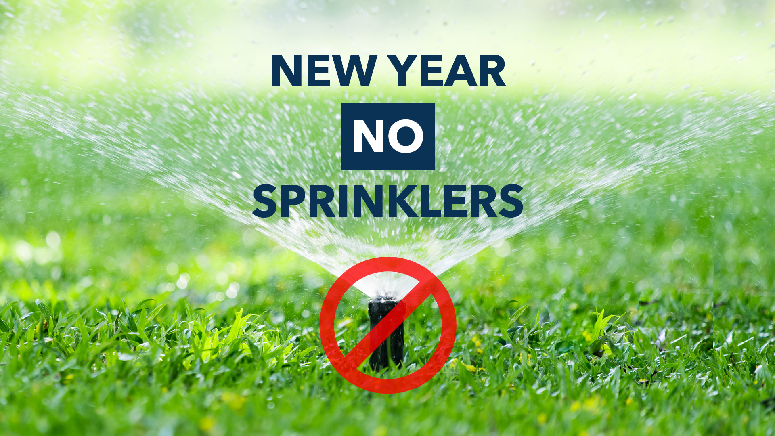
Drought Update: ACWA Communications
Caroline Minasian
Updated Winter Drought Toolkit available at acwa.com/resources.
Social posts and graphics
Newsletter/article
Drought talking points
Ag-related talking points

Slide 6
WUE Objective Update: Status
Elizabeth Lovsted
Components | Recs/ Draft Available | Final Approved
Indoor Residential WUE Standard | Yes – 11/30/21 | Yes – 9/28/22
Water Loss Standard | Yes – 9/2/22 | Yes - 10/18/22
Outdoor Residential WUE Standard (ORWUS) | Yes – Oct. 28
WUE Standards for CII Outdoor Irrigation of Landscape Area with Dedicated Irrigation meters | Yes – Oct. 28
Variances for Unique Uses of Water | Yes – Oct. 28
CII Water Use Performance Measures | Yes – Oct. 28
Guidelines and Methodologies for Calculating Urban Water Use Objectives | Yes – Oct. 28
UWMP and WSCP Guidelines | Yes | Yes – 3/21

Slide 7
WUE Objective Update: Schedule & Status
Elizabeth Lovsted
Components | Standards
Variances for Unique Uses of Water | ‘Sufficient evidence supports the establishment of 8 variances identified in the legislation.”
Water Loss Standard | See Individual System Loss Standards or alternative compliance pathway
Outdoor Residential WUE Standard (ORWUS) | 0.8 for 2023, and 0.63 for 2030 0.55 for new landscapes, or MWELO ETAF as amended
*Urban water suppliers shall achieve the urban water use objective by Jan. 1, 2027.

Slide 8
WUE Objective Update: DWR Recommended Outdoor Standards
Fiona Sanchez
Irrigated Area and Water Source | Residential | Dedicated Irrigation Meter (DIM)
Irrigated (II) – potable | 2023-2030: 0.8 2030 on: 0.63 | 2023-2030: 0.8 2030 on: 0.63
Irrigable, not currently Irrigated (INI) May be adjusted based on future studies | 20% of INI 2023-2030: 0.8 2030 On: 0.63 | No INI component
Special Landscape Areas Sports fields, functional turf Irrigated with Recycled Water | 2023-2030: 0.8 2030 On: 0.63 | 1.0
New Construction and Rehabilitated Landscapes (post Jan 1, 2020) | 0.55 | 0.45
Landscape Area Measurement | Provided by DWR May be adjusted with water supplier data | Suppliers to identify and complete measurements within 5 years after adoption

Slide 9
WUE Objective Update: Outdoor Standards
Fiona Sanchez
Additional SLAs for CII Dedicated Irrigation Meters
Bioengineered slopes
Public swimming pools
Supplemental water for ponds or lakes, including sustaining wildlife, recreation or other public benefits
Exempt Landscapes: exempt landscapes in Gov. Code 65598 and 2015 MWELO
Cemeteries
Registered historical sites
Ecological restoration projects that do not require permanent irrigation
Botanical gardens and arboretums open to the public
Effective Precipitation
Would reduce outdoor budget by up to 25%
Not addressed in recommendations to State Board, but previously incorporated into DWR’s proposed calculation formula

Slide 10
WUE Objective Update: Variances
Elizabeth Lovsted
DWR has concluded that sufficient evidence supports the establishment of the eight variances identified in the 2018 Legislation
Per the 2018 Legislation, appropriate variances may include, but are not limited to, the following eight identified in WC Section 10609.14(b):
Significant use of evaporative coolers
Significant populations of horses and other livestock
Significant fluctuations in seasonal populations
Significant landscape areas irrigated with recycled water having high levels of total dissolved solids
Significant use of water for soil compaction and dust control “for horse corrals and animal exercising arenas
Significant use of water to supplement ponds and lakes to sustain wildlife
Significant use of water to irrigate vegetation for fire protection “significant use of water during major emergencies”
Significant use of water for commercial and noncommercial agricultural use

Slide 11
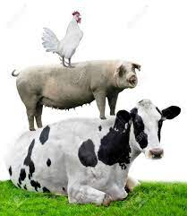
WUE Objective Update: Variances
Elizabeth Lovsted
For each variance, the recommendation includes a threshold of significance and guidelines and methodologies for calculating efficient water use allowable under that variance.
Any URWS that would like to use this variance would need to request it from the State Water Board and receive specific approval on an individual URWS level in order to use the variance in calculating its UWUO.

Slide 12
WUE Objective Update: CII Performance Measures
Ariel Flores
CII Water Use Classification System
19 categories of water uses
Complete classifications within 5 years from SWRCB adoption
DWR to provide technical assistance and develop guidance for CII mapping
CII Conversion Threshold
1 acre of landscape area irrigated by a mixed-use meter on a per parcel basis
Complete landscape area measurement and determine if a dedicated meter (or equivalent technology) or in-lieu technologies will be implemented within 5 years from SWRCB adoption
In-Lieu Technologies
Includes:
Water budget-based rate structures,
Water budget-based management without a rate structure,
Hardware improvements with enhanced performance,
Remote sensing combined with other data and hardware improvements (cont. next slide)

Slide 13
WUE Objective Update: CII Performance Measures (cont.)
Ariel Flores
In-Lieu Technologies
(5) Landscape plant palette transformation programs,
(6) Others as approved by the State Water Board
Complete landscape in-lieu technologies within 5 years after the first year of landscape measurement under the conversion threshold PM
CII Best Management Practices, Performance Measure, and Threshold for Implementation
Selection of specific CII water user BMPs is subject to local determination
Design CII-BMP implementation program specific to service area that includes:
Threshold of significant are 1) CII water use sector that comprise the top 20 percent of all CII water use, and 2) individual top 2.5 percent of CII water users, excluding process water
At least 1 CII from 5 recommended categories (outreach, technical assistance and education, incentives, landscape, collaboration and coordination, operational)
Supported with documentation demonstrating increased water use efficiency
Complete program development within 3 years after SWRCB adoption

Slide 14
WUE Objective Update: Bonus & Guidelines
Fiona Sanchez
Recommendations for Bonus Incentive, Methods of Calculation, and Supporting Data Requirements
Option 2a with some modification – Last-In-First-Out inclusive of Water Loss Criteria Methodology
Uses delivered amounts of potable recycled water to qualified end uses that implicitly include consideration of system losses
Deferred under SWRCB adopts criteria and regulations for DPR permitting requirements
Recommendations on Guidelines and Methodologies for Calculating UWUO
The comprehensive guidelines and methodologies are contained in the full recommendation report
Compliance with 2020 SB X7-7 Target
Must maintain water use below SB x7-7 targets

Slide 15
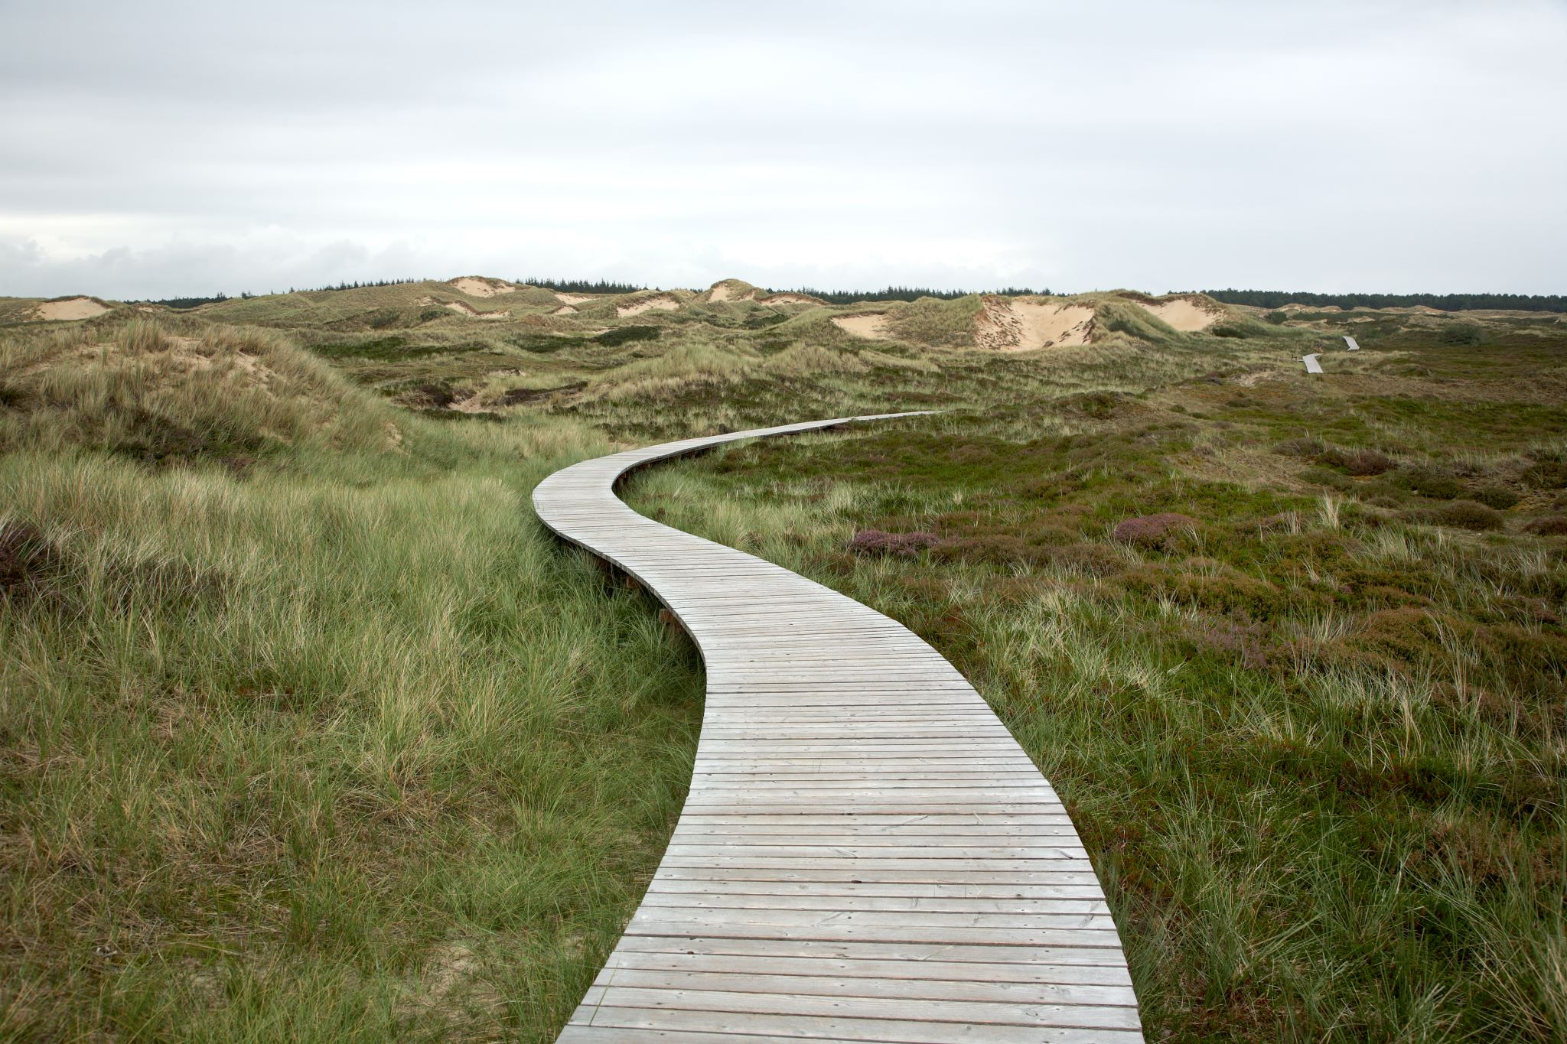
Next Steps
Chelsea Haines & Elizabeth Lovsted

Slide 16
Questions and Comments?
Chelsea Haines, Regulatory Relations Manager
Chelseah@acwa.com

