Slide 1
ACWA Bi-Monthly WUE Meeting
Making Water Conservation a California Way of Life
January 10, 2024
Contact Sonjae@acwa.com to be on the ACWA WUE Distribution lists

Slide 2
AGENDA
Regulation Update - Chelsea Haines
LAO and PPIC – Chelsea Haines
State Water Board Discussions
Small Supplier Alternative Compliance – Elizabeth Lovsted
Outdoor Standard – Fiona Sanchez
Reporting – Jenna Shimmin
Water Reuse – Fiona Sanchez
CII Performance Measures – Ariel Flores
Data Collaborative INI Findings – Elizabeth Lovsted
DWR MWELO Update – Fiona Sanchez
Reporting Updates – Nick Blair

Slide 3
Regulation Update
Chelsea Haines
August 18: Notice of Preparation/ Proposed Regulatory Text
September 6 – October 5: ACWA WG Meetings & Coalition Meetings
October 4: State Water Board Workshop
October 17: Written Comments Due (ACWA Coalition Comment Letter w/ redlines)
November 15 – December 22: Working Group Discussions
Jan/ February: Revised Draft Regulation & Response to Comments
August: State Water Board Consideration to Adopt
End of Year: Regulation Potentially Effective

Slide 4
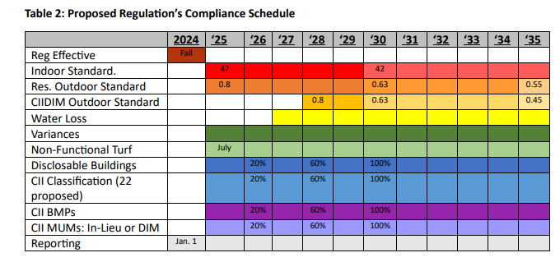
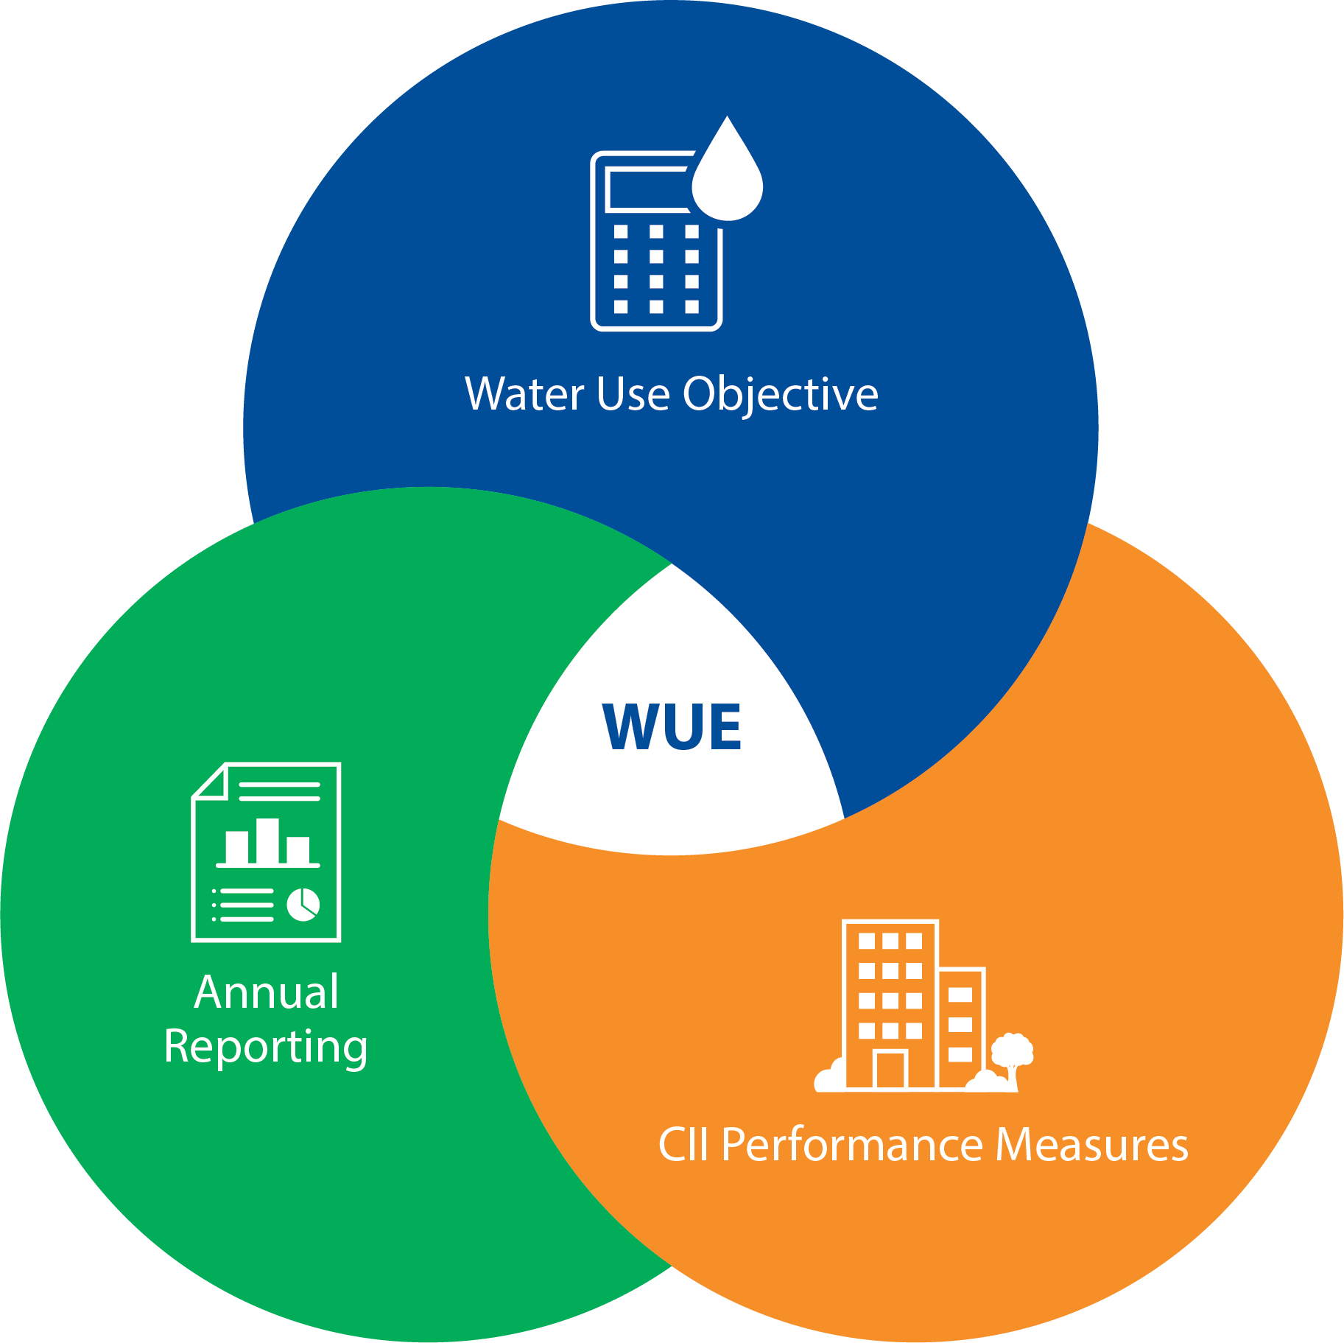
Regulation Update

Slide 5
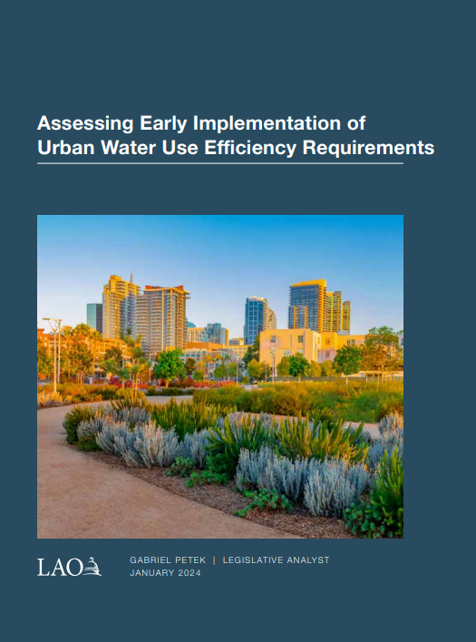
LAO and PPIC Reports
Chelsea Haines
Assessing Early Implementation of Urban Water Use Efficiency Requirements (ca.gov)- LAO Report on Jan. 4, 2024
Finds that draft Regulation “creates implementation challenges and go beyond what legislation requires or DWR recommends.”
Recommendations to the Legislature
Use its oversight authority to make several changes to the framework in the near term as well as key milestones over the coming years.”
Direct SWRCB to simplify several aspects of the framework
Require DWR to provide more technical assistance to suppliers,
Develop a strategy to manage and take advantage of any water saved due to these regulations.

Slide 6
LAO and PPIC Reports
Chelsea Haines
A Better Way to Promote Urban Water Conservation – PPIC Blog on Nov. 28, 2023
Three major challenges:
Very high cost for little benefit
Major affordability concerns
Standards are hard to meet
A better approach
Revert to outdoor water use standards proposed by DWR
Cap required water use reductions
Conduct benefit-cost assessment at the utility level

Slide 7
State Water Board Working Groups
Alternative Compliance for Small Suppliers/ DACs – Elizabeth Lovsted
Eligibility:
For suppliers considered Small (< 30,000 population) or DAC
And that have an unreasonable water use objective (> 20%)
Would include ~ 79 suppliers
Steps:
Notify State Water Board of intent to utilize beginning Jan. 2025
Conduct “Readiness Assessment” with DWR and SWRCB
Develop plan to achieve 1.5% annually
Report on and update plan every 2 years, as needed
Good faith effort (achieved 1.5% through 2035 and can’t cost-effectively achieve an additional savings deemed in compliance).

Slide 8
State Water Board Working Groups
Outdoor Standards - Fiona Sanchez
Timelines – extend timeline by 5 years
INI - include 20% INI area; recalculate if DWR provides updated landscape area data
Effective Precipitation - 100% of modeled effective precipitation or 25% of annual precipitation
Pools – LEF of 1.0 for all pools; not temporary
Alternative Compliance - for Suppliers with Reduction > 20%
Data Error Adjustment - If a supplier is within a specified range (the objective-based actual water use divided by objective is between 100-105%), the supplier is in compliance
Variances – request at 5-year frequency; lower threshold or a cumulative threshold of 5%
Outdoor Standards – retain, only if all other recommendations are included; otherwise 0.8 initial and 0.63 in 2030
Alternative LAM Data – DWR review and approval
References to MWELO – remove references

Slide 9
State Water Board Working Groups
Reporting– Jenna Shimmin
Reporting year – Allow calendar or fiscal
Single submission to both the State Water Board and DWR – DWR approves, SWRCB reviews
Population data – will support manual population changes in SDWIS, as long as methodology doesn’t change
New Construction – alternative data to be allowed
Variance Requests – most don’t need to apply annually, only submit data
Water Loss Audit – Report figure from most recent audit
Reporting Metrics – many kept for agencies who are not able to use alternative data. Others, changed to metric that agencies actually track.
Terminology – changes made to better reflect intent (e.g.connection vs customer)

Slide 10
State Water Board Working Groups
Recycled Water – Fiona Sanchez
Temporary provisions and approval process for recycled water Special Landscape Areas
Recycled water should not be a temporary provision
Simplify approval process to mirror alternative LAM data approval process (all recycled water landscapes are DIMs)
Submit application every 5 years, unless there are changes
Report every year
1.0 Factor for Recycled Water Landscapes
Define as 1.0 for Recycled Water in the Regulation (remove reference to MWELO)
Methodology to calculate Bonus Incentive for Direct Potable Reuse
WateReuse proposed calculation spreadsheet for DPR
Adapted to reflect changes in DPR processes from supported IPR calculation methodology

Slide 11
State Water Board Working Groups
CII Performance Measures – Ariel Flores
Set Reasonable Timelines – Unstack, prescription
CII Classification – energy star, schedule for completion
Large Landscapes with MIM – recognize existing programs, “offer” vs. “employ,” remove quantification of volume of water use on CII MUMs, technical changes
BMPs – disclosable buildings, 80% for all threshold, exemption for de minimis, non-functional turf, technical changes

Slide 12
Data Collaborative INI Findings
Elizabeth Lovsted
California Data Collaborative Blogpost
Water Suppliers in Higher–ET areas more likely to exceed objective without INI.
Analysis using SWRCB provisional data
Compares ET Values with Water Use Objective exceedance

Slide 13
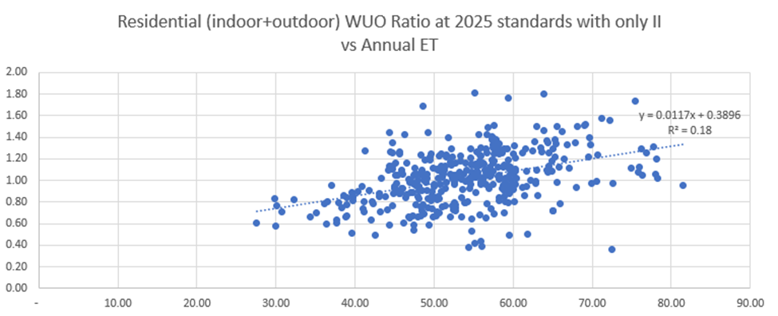
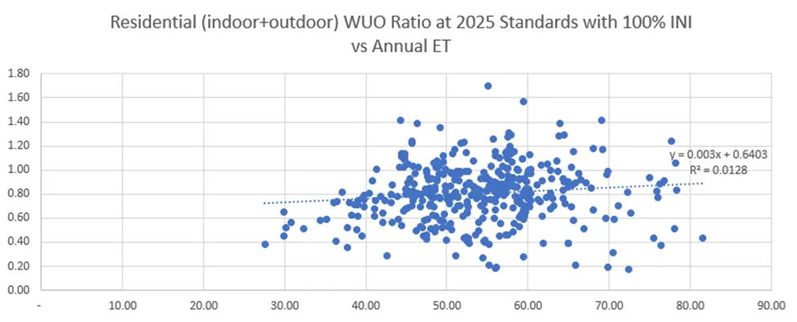
Data Collaborative INI Findings
Elizabeth Lovsted

Slide 14
Data Collaborative INI Findings
Elizabeth Lovsted
Potential Causes
Irrigation of areas classified as “not irrigated” in higher ET areas
Non-irrigated areas classified as irrigated in cooler climates

Slide 15
DWR MWELO Update
Fiona Sanchez
MWELO
Establishes minimum standards for landscape design, construction and management
Department of Water Resources review required at least every 3 years
Current Rulemaking - Proposed Amendments
Does not change standards or current requirements
Simplifies and reorganizes to improve understanding of and compliance with MWELO
Incorporates two new statutory requirements
Public Hearing held January 9, 2024
Written comment period closes January 16, 2024
Email WELO@water.ca.gov
MWELO Public Comment Form

Slide 16
Reporting Updates
Nick Blair

Slide 17
Chelsea Haines Chelseah@acwa.com
January 10, 2024
Contact Sonjae@acwa.com to be on the ACWA WUE Distribution lists

