Slide 1
ACWA Bi-Monthly WUE Meeting
Making Water Conservation a California Way of Life
March 14, 2024
Contact SonjaE@acwa.com to be on the ACWA WUE Distribution lists

Slide 2
What’s Happened & Next Steps
2022
September: DWR Released Recommendations
September: Governor Signed SB 1157 (Hertzberg)
SWRCB Adopted Water Loss Regulation
2023
August 18: SWRCB Initiated Formal Rulemaking/ Released Draft Regulation
October 4: SWRCB Workshop
October 17: Written Comment Period
November – December 21: SWRCB hosted 21 meetings with five workgroups
2024
March 12: Revised Regulation
March 20: SWRCB Workshop
March 27: Written Comments Due
Summer 2024: Regulation Adopted

Slide 3
ACWA Coalition Next Steps
Consider Media Statements!
ACWA to Circulate Draft Coalition Letter – March 19
Send logos to Sonjae@acwa.com by March 25
ACWA to Provide Oral Comments on March 20
ACWA to release Alert & Member Toolkit
Key Messaging:
Concise!
These are ambitious targets (add your 2040 if reduction required).
We appreciate and need the additional flexibility & time
We are ready to implement and plan to do X, Y, Z
Note any remaining concerns/ requested changes (reporting, compliance, etc.).

Slide 4
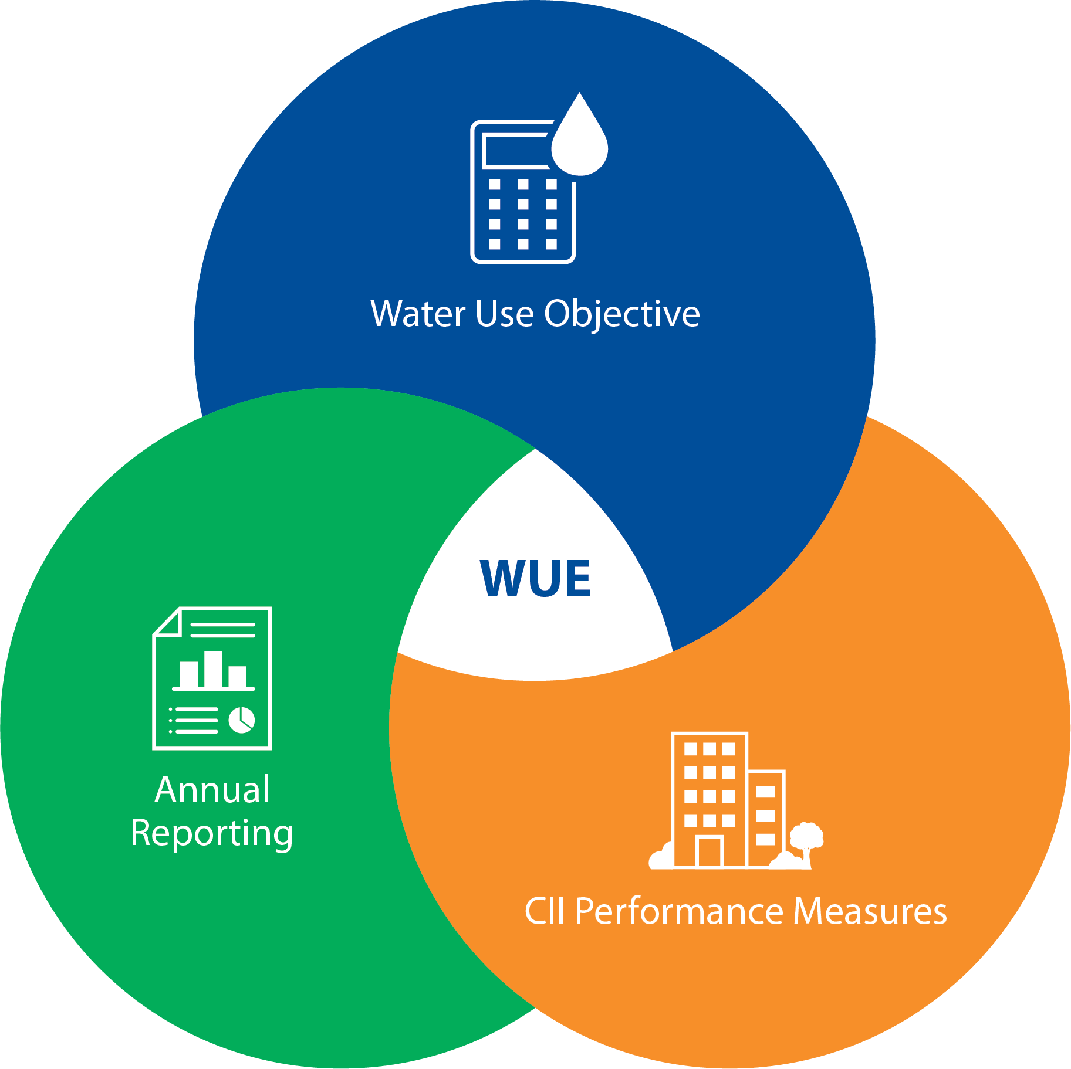
Key changes to the Draft Regulation
Urban Water Use Objective
Outdoor Standards Timeline
20% INI
Other Requested Modifications (Variances, MWELO references, SLAs, Bonus)
Compliance
Alternative Compliance Pathway
CII Performance Measures
Timelines & Implementation Schedule
Other Technical Changes
Reporting
975 new requirements

Slide 5
Changes: UWUO
1. Outdoor Standards Timeline
Landscape Efficiency Factor |  | DWR’s 2022 Recs | August 2023 Draft | March 2024 Draft
Residential | CII w/ DIMs
0.80 | 0.80 | Until 2030 | Until 2030 | Until 2035
0.63 | 0.63 | Starting in 2030 | Starting in 2030 | Starting in 2035
0.55 | 0.45 | n/A | Starting in 2035 | Starting in 2040
ACWA Recommendation (10/23): Modify the proposed timelines for the outdoor standards to provide an additional 5 years for all suppliers to achieve compliance.
Proposed timelines are not reasonable, and do not support cost-effective compliance, and would not achieve the multi-benefits desired

Slide 6
Changes: UWUO
2. Inclusion of 20% irrigable, non-irrigated credit
DWRs 2022 Recs | August 2023 Draft | March 2024 Draft
Always include for everyone | For suppliers that need it to comply, include until 2027 | For suppliers that need it to comply, include unless and until landscape area is updated
ACWA Recommendation (10/23): The draft Regulation should reflect DWR’s recommendation with the inclusion of 20 percent INI. Suppliers would recalculate INI when DWR provides new LAM data.
Consistent with legislation - The Conservation Legislation requires outdoor efficiency standards to apply to “irrigable lands” (Wat. Code, § 10609.6 (2)(B))
Not a “buffer.” DWR statistical analysis conducted indicated that INI area is being irrigated at one fifth or 20% of the irrigable area

Slide 7
Changes: UWUO
3. Other Requested Modifications
Variances
Every 5-years
Water use for any individual variance represents 5% or more of the associated budget for the UWO standard
Standards decoupled from MWELO
Special Landscape Areas – Landscape Efficiency Factor 1.0
Recycled water defined as 1.0
Residential SLAs includes pools and spas
Bonus incentive
Methodology for Direct Potable Reuse added

Slide 8
Changes: UWUO
3. Compliance with Objective to Begin 2027
DWRs 2022 Recs | August 2023 Draft | March 2024 Draft
N/A | Compliance deferred until 2025 | Compliance deferred until 2027
ACWA Recommendation (10/23):
Timelines proposed in the draft Regulation are not reasonable, do not support cost-effective compliance,
The regulation is behind schedule and the legislative intended for a progress compliance schedule.

Slide 9
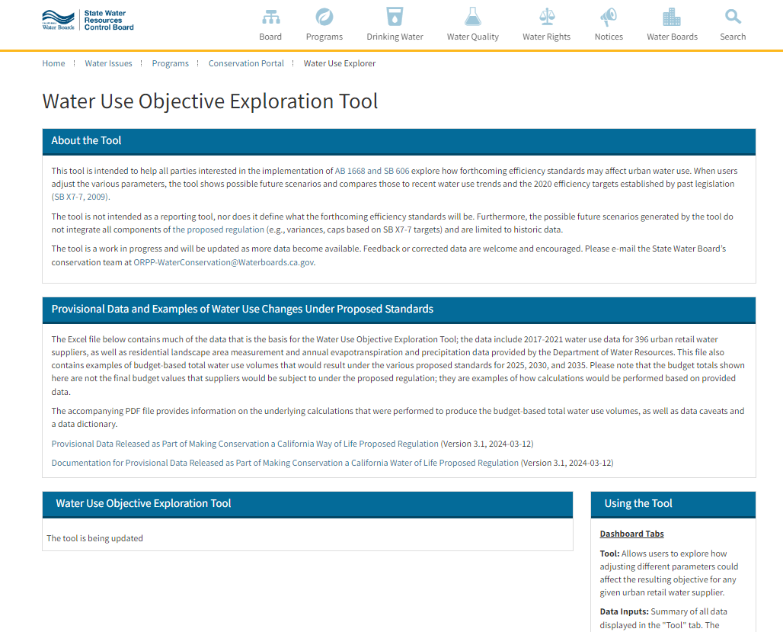
Updated Provisional Data
Check the SWRCB’s updated provisional data
Click here to download and review data & 2030, 2035 & 2040 WUO
https://www.waterboards.ca.gov/water_issues/programs/conservation_portal/water-use-explorer/

Slide 10
Changes: UWUO Compliance
3. Compliance with Objective to Begin 2027
 | August 2023 Version |  | March 2024 Version
 | 2040 Compliance |  | 2035 Compliance
CII PMs & Reporting | 18% | 71 | 31% | 121
< 5% | 9% | 35 | 8% | 31
5 – 10% | 11% | 43 | 13% | 50
10 – 20% | 21% | 82 | 21% | 84
20 – 30% | 20% | 81 | 15% | 61
> 30% | 21% | 84 | 12% | 49

Slide 11
Changes: UWUO Compliance
4. Alternative Compliance Pathway
 | Eligibility Thresholds |  | Required Effort | Result for Supplier
 | Income of Population Served | Percentage Reduction
March 2024 Draft | < MHI | >20% | Reduce water use by >1% per year Plan to achieve its UWUO | Supplier deemed in compliance
 | > MHI | >30% | Reduce water use by > 2% per year Verify adherence to G480 standard Plan to achieve its UWUO | Supplier deemed in compliance
August 2023 Draft | < 80% of MHI | > 20% | Reduce water use by > 2% per year | Use of 0.63 for outdoor standards through 2040
 | Any | > 20% | Reduce water use by > 2$ per year Verify adherence to G480 & Tree City USA standards Have a program dedicated to climate ready trees
DWR Recs | The SWRCB consider a limited-time cap on the annual reductions that supplier would be expected to make
ACWA Recommendation (10/23): Work collaboratively to develop an Alternative Compliance Pathway” that allows suppliers that have an unreasonable or unattainable water use objective to be eligible for an alternative objective and/or extension of time to comply.
Proposed alternative compliance does not address feasibility concerns and is not attainable for many.

Slide 12
Changes: UWUO Compliance
4. Alternative Compliance Pathway

Slide 13
Changes: CII Performance Measures
Timelines and Implementation Schedule
CII Classification | August 2023 Version | March 2024 Version
Classify 20% | By 2026 | NA
Classify 60% | By 2028 | NA
Classify 100% | By 2030 | By 2027
Maintain 95% | 2030 onwards | 2028 onwards
MUM Conversion | August 2023 Version | March 2024 Version
Identify MUM | N/A | 06/27 or 06/29
20% Convert or In-Lieu | By 2026 | NA
60% Convert or In-Lieu | By 2028 | NA
100% Convert or In-Lieu | By 2030 | 06/2039
Maintain 95% Conversion or In-Lieu | 2030 onwards | 06/2040

Slide 14
Changes: CII Performance Measures
Timelines and Implementation Schedule
BMPs | August 2023 Version | March 2024 Version
Identify Disclosable Buildings | 01/2025 | 06/2024 or Effective Date
Top 20th % in each Classification Conservation Program Design & Implement |  | 1. 06/2025 – ID top 2.5% CII Users & Top 20% CII Users (Track 1) 2. 06/2027 – ID top 2.5% CII Users & Top 20% CII Users in each Classification (Track 2) 3. 06/2029 – ID CII Users based on Supplier Defined Thresholds (Track 3)
Top 2.5% Customer Conservation Program Design & Implementation
Non-Functional Turf Ban | 07/2025 | 01/2027
Implement for 20% of the Following: Disclosable Building Reporting Top 20th %-ile in each Classification Top 2.5% Customer Conservation Program | By 2026 | N/A

Slide 15
Changes: CII Performance Measures
Timelines and Implementation Schedule
BMPs | August 2023 Version | March 2024 Version
Implement for 60% of the Following: Disclosable Building Reporting Top 20th %-ile in each Classification Conservation Program Top 2.5% Customer Conservation Program | By 2028 | N/A
Implement for 100% of the Following: Disclosable Building Reporting Track 1, Track 2, or Track 3 | By 2030 | 06/2039

Slide 16
Changes: CII Performance Measures
Timelines and Implementation Schedule

Slide 17
Changes: CII Performance Measures
2. Other Technical Changes
MUM Conversion
Large Landscape Threshold : ½ acre of landscape
MUM Identification schedule depends on area or volumetric evaluation
1 in-lieu technology instead of two
BMPs: Outreach and Landscape (irrigation system inspection & irrigation scheduling training)
BMPs
Disclosable Building Reporting – use the list of disclosable buildings, upon request of the building owner with ENERGY STAR Format
CII Customer Identification schedule and Conservation Program Requirements – Choose your own adventure
Key Business Activity Indicator (Supplier Defined Threshold)

Slide 18
Changes: Reporting
3. Reporting
Fiscal Year Reporting
Conflict with other reporting requirements (eAR,
water loss, etc.)
Indoor standards effective January 1st
Population value comes from eAR
Outdoor standards effective July 1st
How to adjust Water Loss for CY vs. FY?
975 - New Reporting Requirements
975(a)&(e) “…supplier must submit to the Department and the Board…” (pgs 46 & 47)
Reports due by Jan 1st on a machine-readable form provided by the Board

Slide 19
Changes: Reporting
3. Reporting
975 - New Reporting Requirements (continue)
(d)(1)(A)(iii) and (iv) Reporting of 90th percentile SFR & MFR customers volume for what purpose & what statutory requirement?
(d)(2) Excluded CII, other, & ag water use to be reported, despite not being in the UWUO
(e)(1) Start reporting July 2025 on CII classifications (972), but 972 has this begin July 2027
(e)(2-4) Estimated annual water savings with In-Lieu Technologies & BMPs
Why? How? Imprecise and impractical, hence it was taken out of the UWUO
Water use varies so much; multiple BMPs, how to estimate water savings?
Key Business Activity Indicators (KBAI) – how best to determine
Track every BMP on offer to every CII customer is overly burdensome

Slide 20
WANT MORE INFORMATION?
For more information:
Chelsea Haines
Regulatory Relations Manager
Association of California Water Agencies
chelseah@acwa.com
To participate in ACWA’s Working Group or Bi-Monthly WUE Meetings:
Visit CalWEP’s What the Framework Blog: https://calwep.org/framework-updates/
Sonja Eschenburg
State Relations Assistant
Association of California Water Agencies
sonjae@acwa.com

